Slide 1
Elastic Weight Consolidation on X-ray images
Renato Santos Aranha Jan/2021

Slide 2
Elastic Weight Consolidation
DenseNet
Datasets
Methodology
Results
Conclusion

Slide 3
Elastic Weight Consolidation
Kirkpatrick et al. [2017]
The idea: inspired by human brain in which synaptic consolidation enables continual learning by reducing the plasticity of synapses related to previous learned tasks
plasticity of weights closely related to previous tasks → more prone to cause catastrophic forgetting

Slide 4
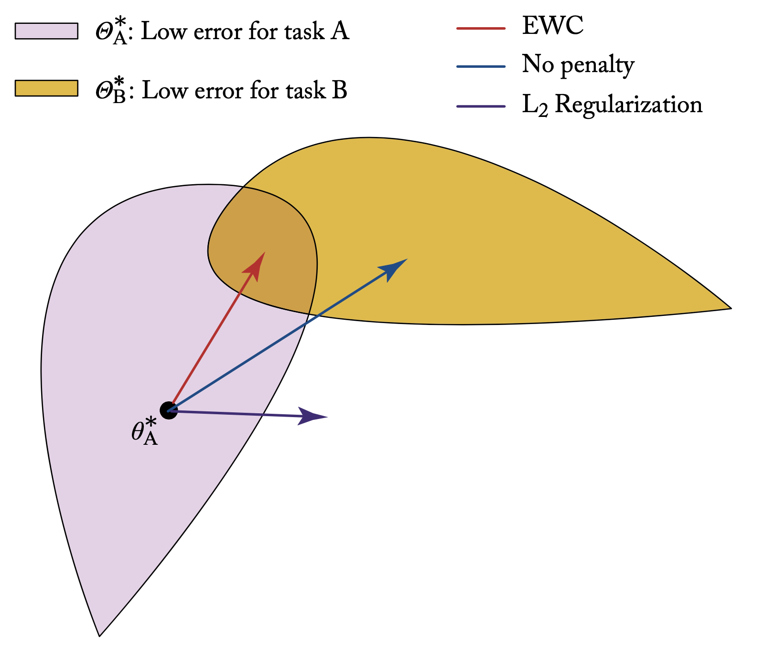
Elastic Weight Consolidation
Kirkpatrick et al. [2017]
The idea: inspired by human brain in which synaptic consolidation enables continual learning by reducing the plasticity of synapses related to previous learned tasks
plasticity of weights closely related to previous tasks → more prone to cause catastrophic forgetting
EWC:
quantify weights importance in terms of impact on previous tasks
constraint parameters to low-error task regions
selectively decrease the plasticity of those important weights to previous tasks

Slide 5
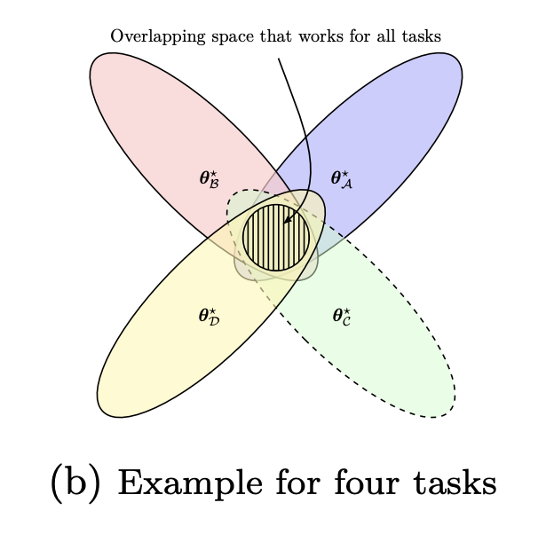
Elastic Weight Consolidation
Kirkpatrick et al. [2017]
The idea: inspired by human brain in which synaptic consolidation enables continual learning by reducing the plasticity of synapses related to previous learned tasks
plasticity of weights closely related to previous tasks → more prone to cause catastrophic forgetting
EWC:
quantify weights importance in terms of impact on previous tasks
constraint parameters to low-error task regions
selectively decrease the plasticity of those important weights to previous tasks

Slide 6
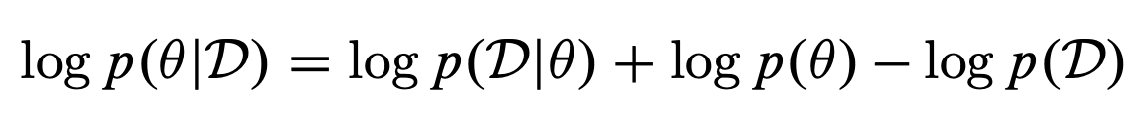
Elastic Weight Consolidation
Kirkpatrick et al. [2017]
The idea: inspired by human brain in which synaptic consolidation enables continual learning by reducing the plasticity of synapses related to previous learned tasks
plasticity of weights closely related to previous tasks → more prone to cause catastrophic forgetting
importance modeled as posterior distr. P(θ|D)
(prob. of parameter θ given a task’s training data D)
EWC:
quantify weights importance in terms of impact on previous tasks
constraint parameters to low-error task regions
selectively decrease the plasticity of those important weights to previous tasks
Using Bayes rule:

Slide 7
Elastic Weight Consolidation
Kirkpatrick et al. [2017]
The idea: inspired by human brain in which synaptic consolidation enables continual learning by reducing the plasticity of synapses related to previous learned tasks
plasticity of weights closely related to previous tasks → more prone to cause catastrophic forgetting
importance modeled as posterior distr. P(θ|D)
(prob. of parameter θ given a task’s training data D)
EWC:
quantify weights importance in terms of impact on previous tasks
constraint parameters to low-error task regions
selectively decrease the plasticity of those important weights to previous tasks
Using Bayes rule:
all the information related to task A
intractable…

Slide 8
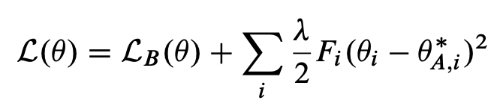
Elastic Weight Consolidation
Kirkpatrick et al. [2017]
The idea: inspired by human brain in which synaptic consolidation enables continual learning by reducing the plasticity of synapses related to previous learned tasks
plasticity of weights closely related to previous tasks → more prone to cause catastrophic forgetting
importance modeled as posterior distr. P(θ|D)
(prob. of parameter θ given a task’s training data D)
EWC:
quantify weights importance in terms of impact on previous tasks
constraint parameters to low-error task regions
selectively decrease the plasticity of those important weights to previous tasks
Using Bayes rule:
all the information related to task A
intractable…

Slide 9
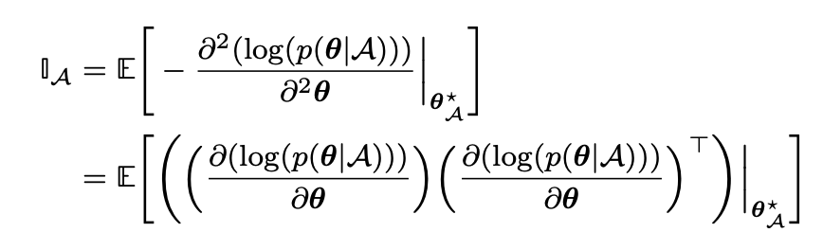
Elastic Weight Consolidation
Kirkpatrick et al. [2017]
The idea: inspired by human brain in which synaptic consolidation enables continual learning by reducing the plasticity of synapses related to previous learned tasks
plasticity of weights closely related to previous tasks → more prone to cause catastrophic forgetting
importance modeled as posterior distr. P(θ|D)
(prob. of parameter θ given a task’s training data D)
EWC:
quantify weights importance in terms of impact on previous tasks
constraint parameters to low-error task regions
selectively decrease the plasticity of those important weights to previous tasks
Using Bayes rule:
all the information related to task A
intractable…
curvature represent the sensitivity of the
network with respect to the optimum!

Slide 10
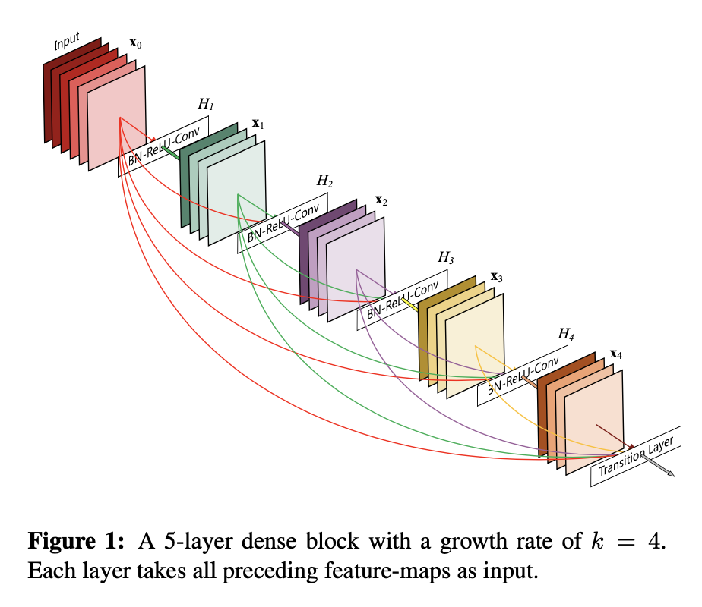
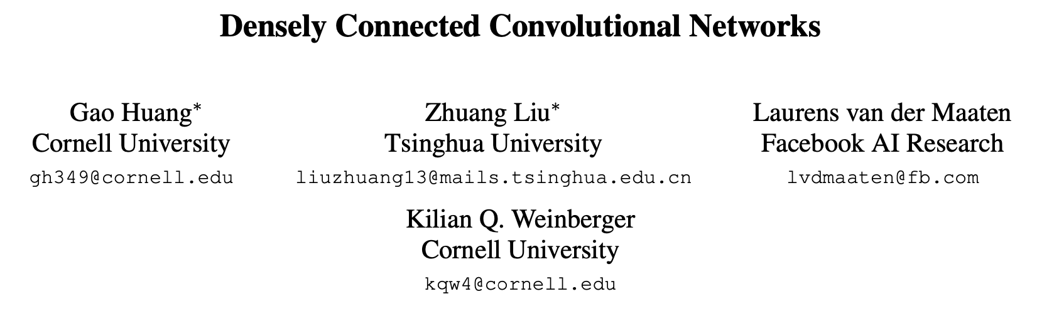
DenseNet (Huang et al, 2018)
improve the information flow between layers!

Slide 11
Datasets
China Set - The Shenzhen set - Chest X-ray Database
Montgomery County - Chest X-ray Database
Stanford CheXpert Database
image database for Tuberculosis
National Library of Medicine, Maryland, USA + Shenzhen No.3 People’s Hospital, Guangdong Medical College, Shenzhen, China
X-rays captured as part of the daily routine using Philips DR Digital Diagnose systems
Number of X-rays: - 336 cases with manifestation of tuberculosis - 326 normal cases.
Image parameters: - Format: PNG - Image size varies (approximately 3K x 3K)
image database for Tuberculosis
National Library of Medicine, Maryland, USA + Department of Health and Human Services, Montgomery County, Maryland, USA
X-rays collected under Montgomery County`s Tuberculosis screening program
Number of X-rays: - 58 cases with manifestation of tuberculosis - 80 normal cases.
Image parameters: - Format: PNG - 4020x4892 and 4892x4020.
image database for various diseases (here we use Pneumonia)
CheXpert is a large dataset of chest X-rays (and competition) for automated chest x-ray interpretation, which features radiologist-labeled reference standards.
chest radiographic examinations from Stanford Hospital, performed between October 2002 and July 2017
Number of X-rays:
- 224k chest radiographs of 65k patients. Here: - 1.065 cases with Pneumonia - 1.070 cases with NO Pneumonia Image parameters: - Format: PNG - 320x390

Slide 12
Datasets
China Set - The Shenzhen set - Chest X-ray Database
Stanford CheXpert Database
image database for Tuberculosis
National Library of Medicine, Maryland, USA + Shenzhen No.3 People’s Hospital, Guangdong Medical College, Shenzhen, China
X-rays captured as part of the daily routine using Philips DR Digital Diagnose systems
Number of X-rays: - 336 cases with manifestation of tuberculosis - 326 normal cases.
Image parameters: - Format: PNG - Image size varies (approximately 3K x 3K)
image database for various diseases (here we use Pneumonia)
CheXpert is a large dataset of chest X-rays (and competition) for automated chest x-ray interpretation, which features radiologist-labeled reference standards.
chest radiographic examinations from Stanford Hospital, performed between October 2002 and July 2017
Number of X-rays:
- 224k chest radiographs of 65k patients. Here: - 1.065 cases with Pneumonia - 1.070 cases with NO Pneumonia Image parameters: - Format: PNG - 320x390

Slide 13
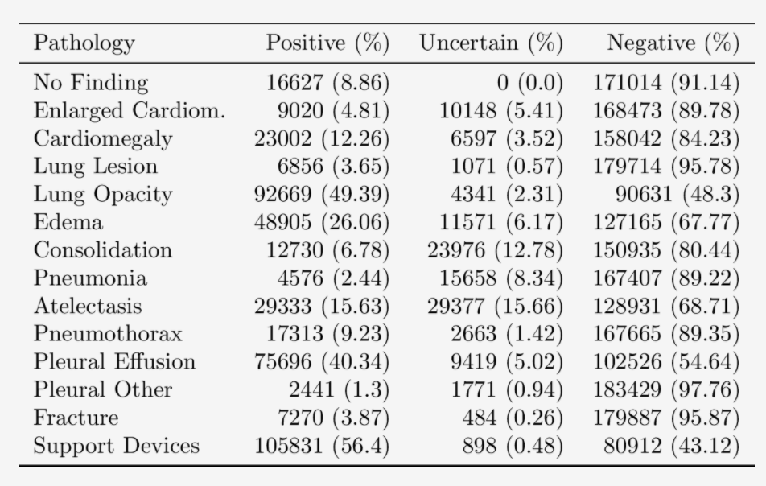
Datasets
China Set - The Shenzhen set - Chest X-ray Database
Stanford CheXpert Database
image database for Tuberculosis
National Library of Medicine, Maryland, USA + Shenzhen No.3 People’s Hospital, Guangdong Medical College, Shenzhen, China
X-rays captured as part of the daily routine using Philips DR Digital Diagnose systems
Number of X-rays: - 336 cases with manifestation of tuberculosis - 326 normal cases.
Image parameters: - Format: PNG - Image size varies (approximately 3K x 3K)
image database for various diseases (here we use Pneumonia)
CheXpert is a large dataset of chest X-rays (and competition) for automated chest x-ray interpretation, which features radiologist-labeled reference standards.
chest radiographic examinations from Stanford Hospital, performed between October 2002 and July 2017
Number of X-rays:
- 224k chest radiographs of 65k patients. Here: - 1.065 cases with Pneumonia - 1.070 cases with NO Pneumonia Image parameters: - Format: PNG - 320x390

Slide 14
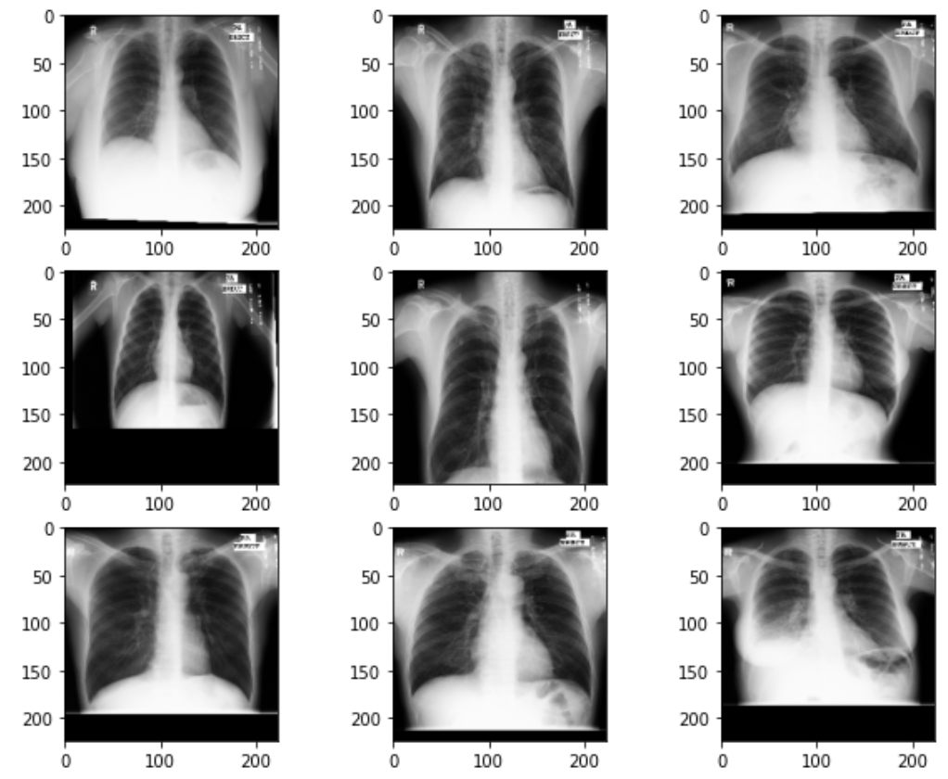
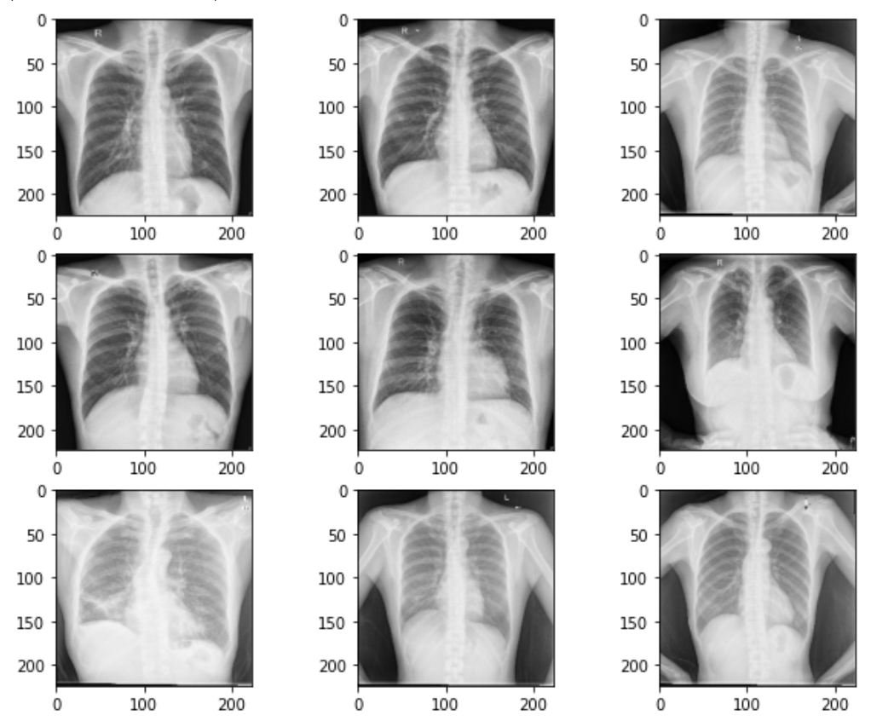
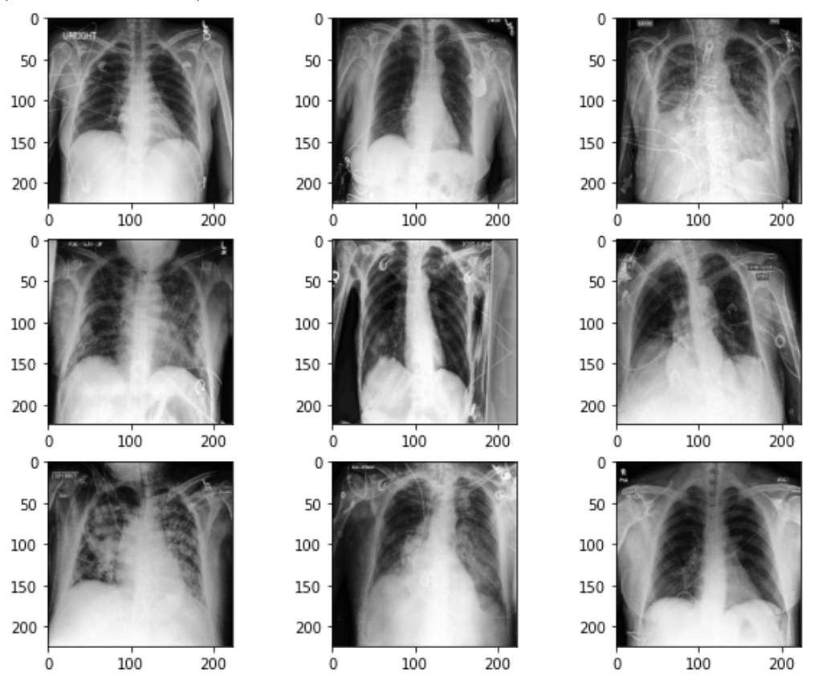
Datasets
China Set - The Shenzhen set - Chest X-ray Database
Montgomery County - Chest X-ray Database
Stanford CheXpert Database

Slide 15
Datasets
China Set - The Shenzhen set - Chest X-ray Database
Stanford CheXpert Database

Slide 16
Experimental Design
Objective
investigate potential benefit of LL on domain shift distribution
How
network trained on Shenzhen and then on Stanford;
Starting point → pre-trained DenseNet121 (Huang et al., 2018)
(commonly employed net in X-ray domain)
last layers (FC part) → two linear layers
(ReLU and Sigmoid). Dropout 0.6.
Loss function → Binary cross entropy.
Optimization → SGD (learning rate 0.01, mini-batch of 16).
all images rescaled to 224 × 224

Slide 17
Experimental Design
four strategies:
standard fine-tuning using second task only;
fine-tuning using EWC “regularization term”; (forgetting impact of λ = 0.7 and 10, empirical Fisher matrix calculated over first task
ELLA;
One-class SVM;

Slide 18
Experimental Design
four strategies:
standard fine-tuning using second task only;
fine-tuning using EWC “regularization term”; (forgetting impact of λ = 0.7 and 10, empirical Fisher matrix calculated over first task
ELLA; ☹
One-class SVM; ☹

Slide 19
Results
Task 1 → Montgomery dataset
Task 2 → Shenzhen dataset
Task 3 → Stanford dataset

Slide 20
Results
Task 2 → Shenzhen dataset
Task 3 → Stanford dataset

Slide 21
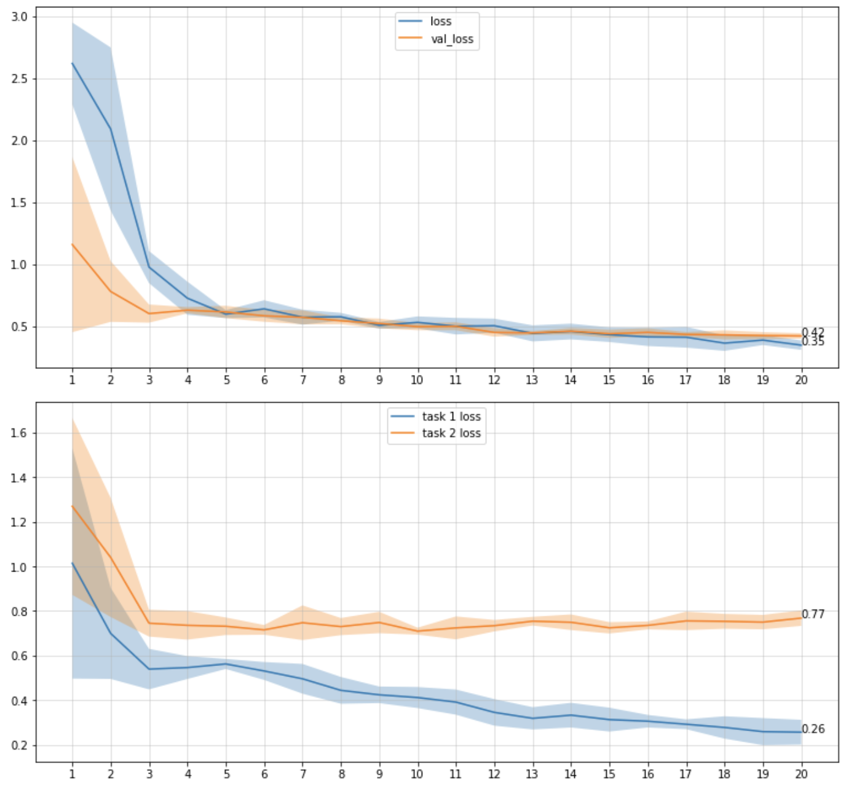
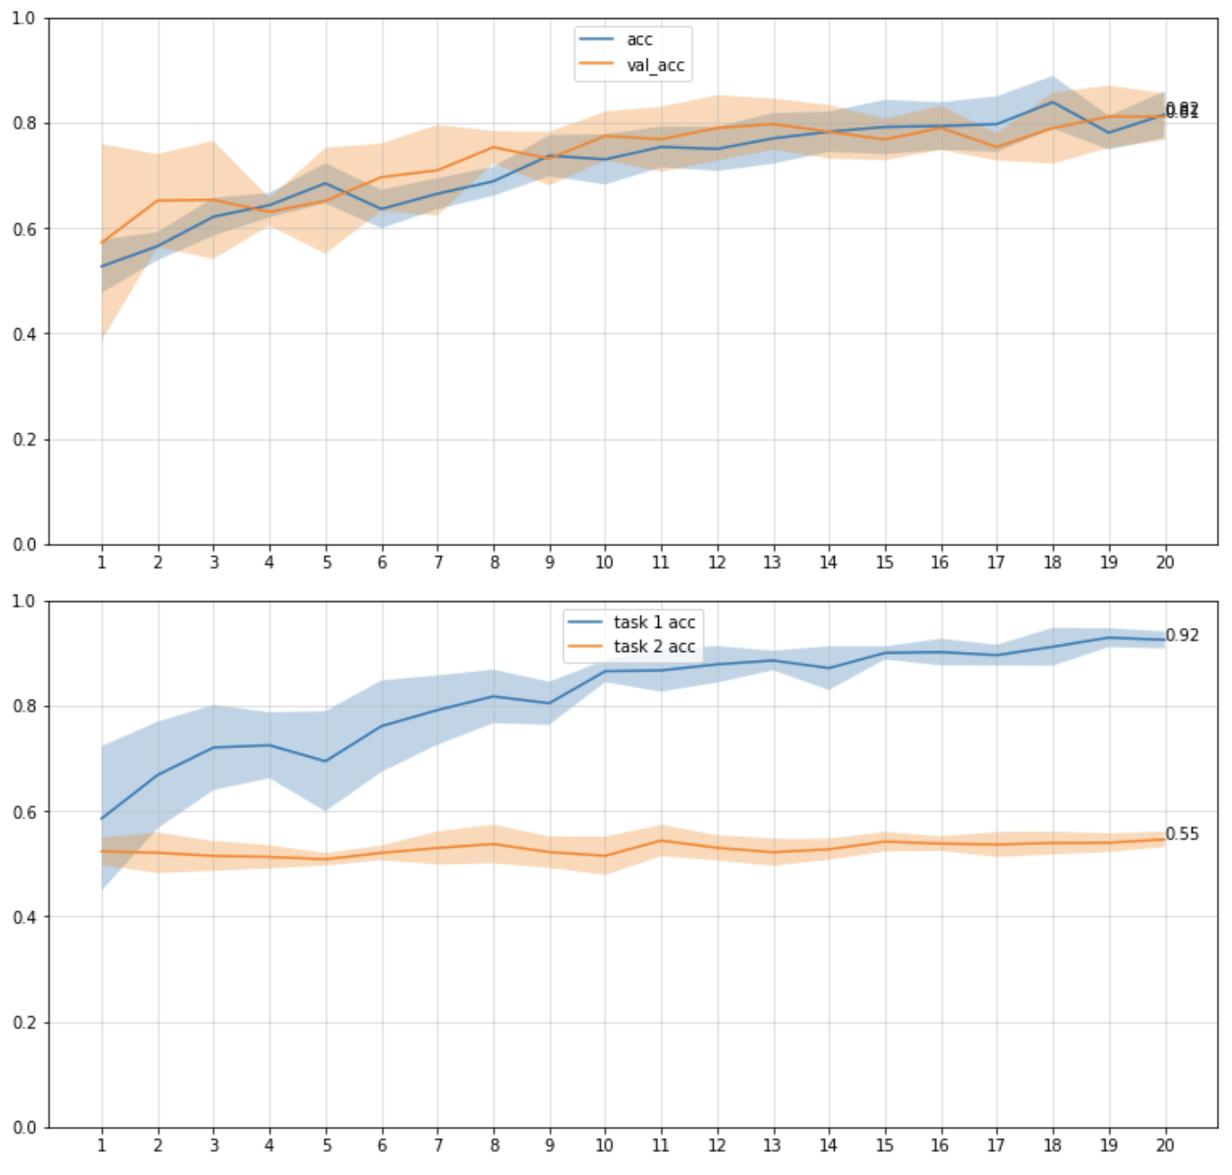
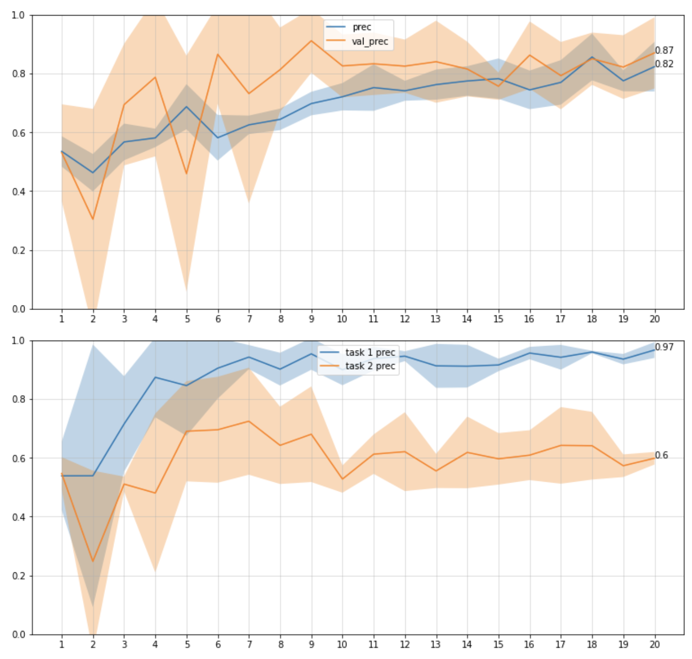
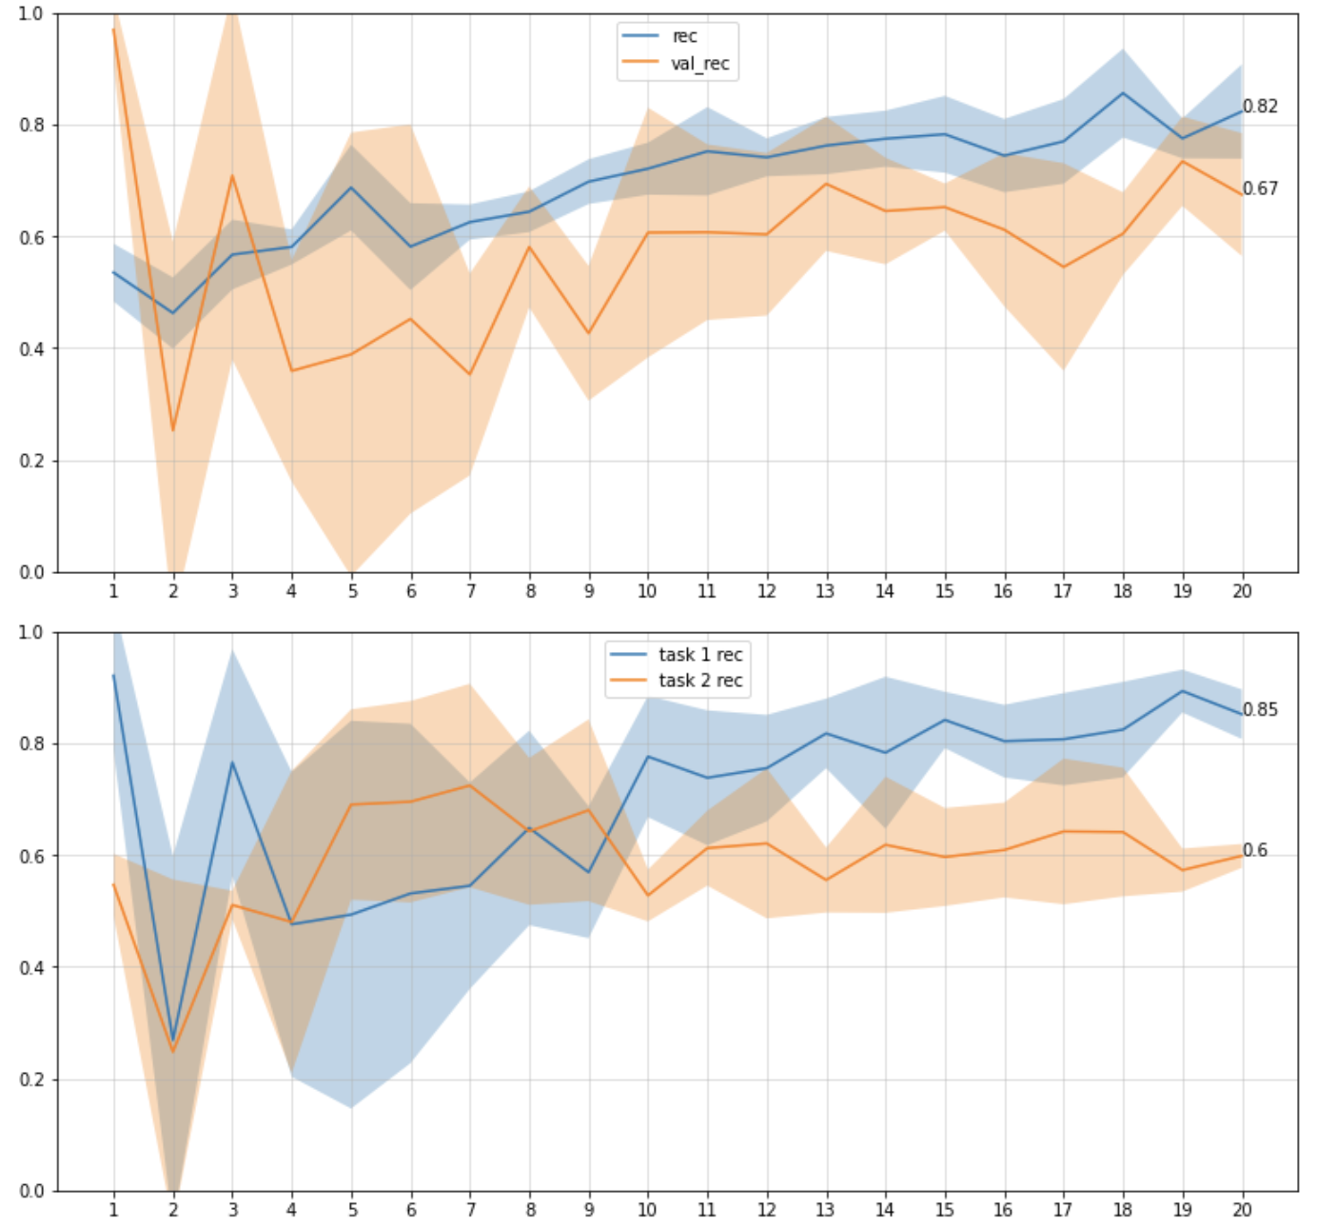
Results - EWC
Task 1 only
Model evaluation
on tasks

Slide 22
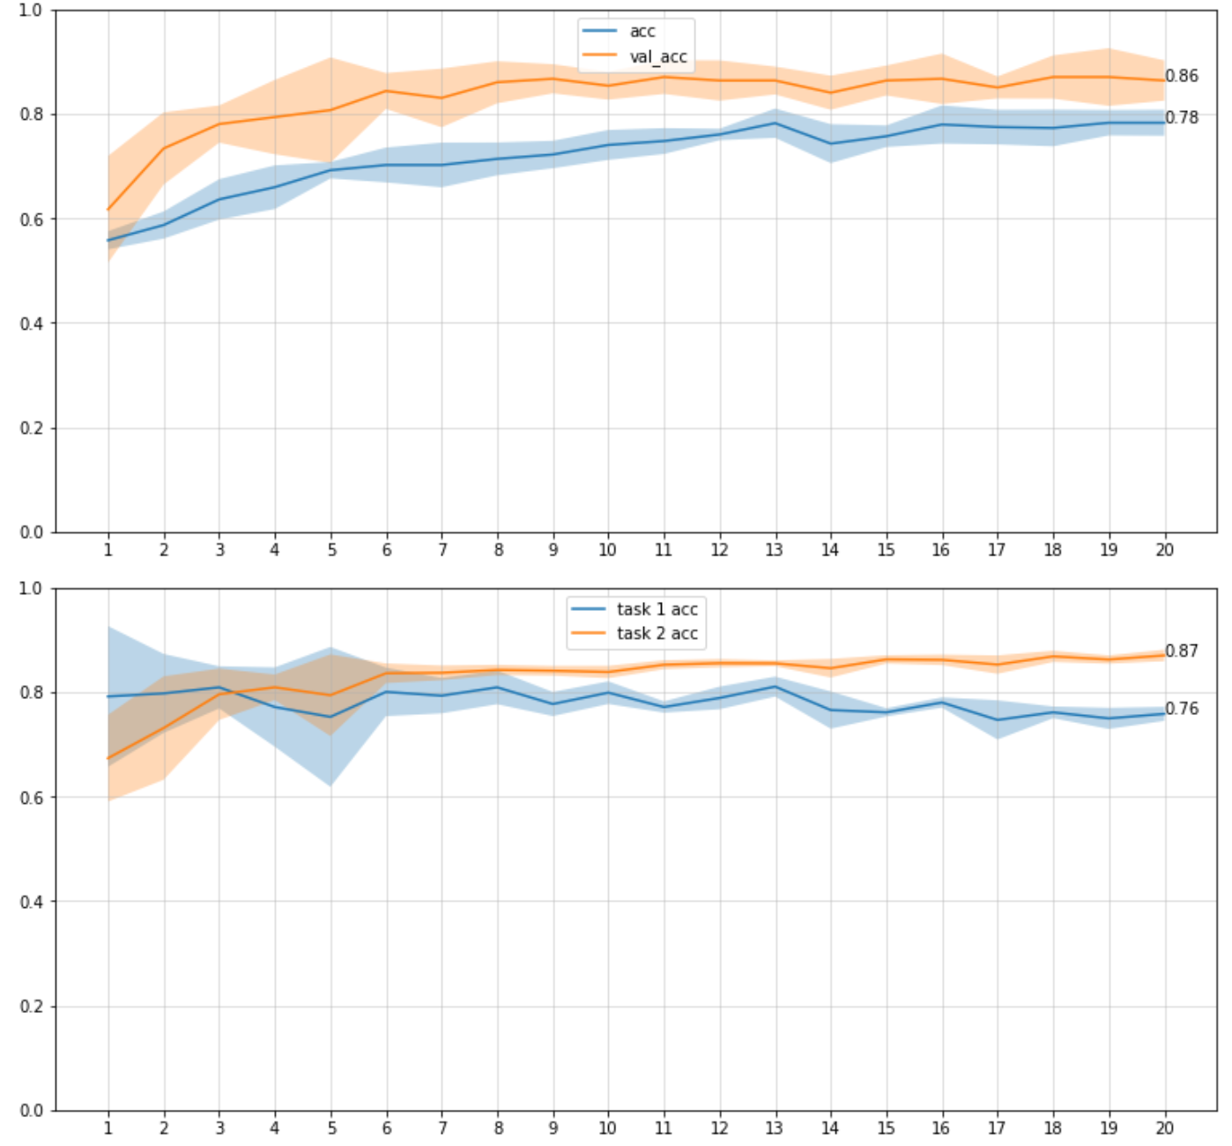
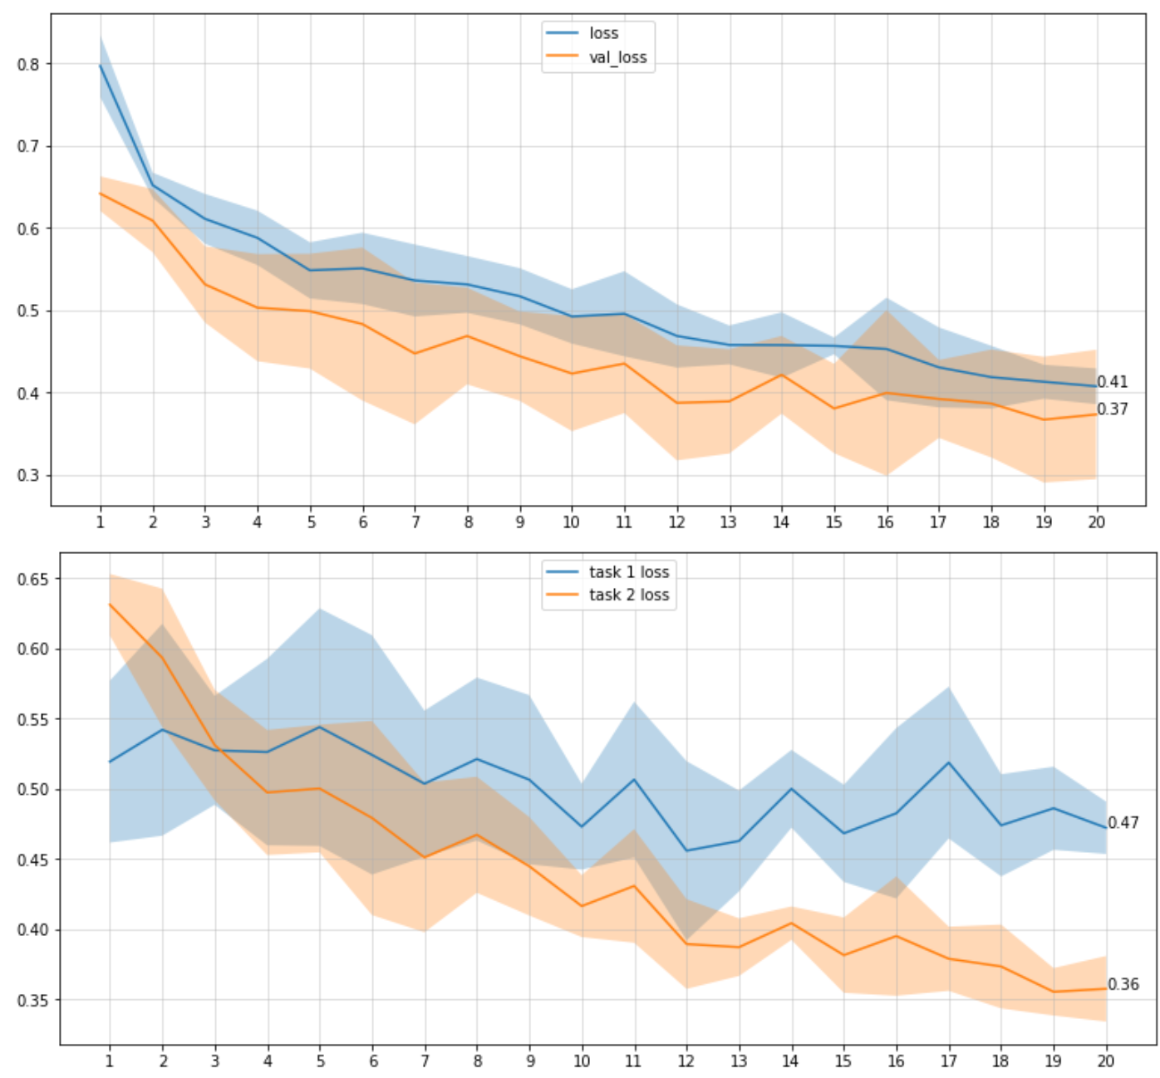
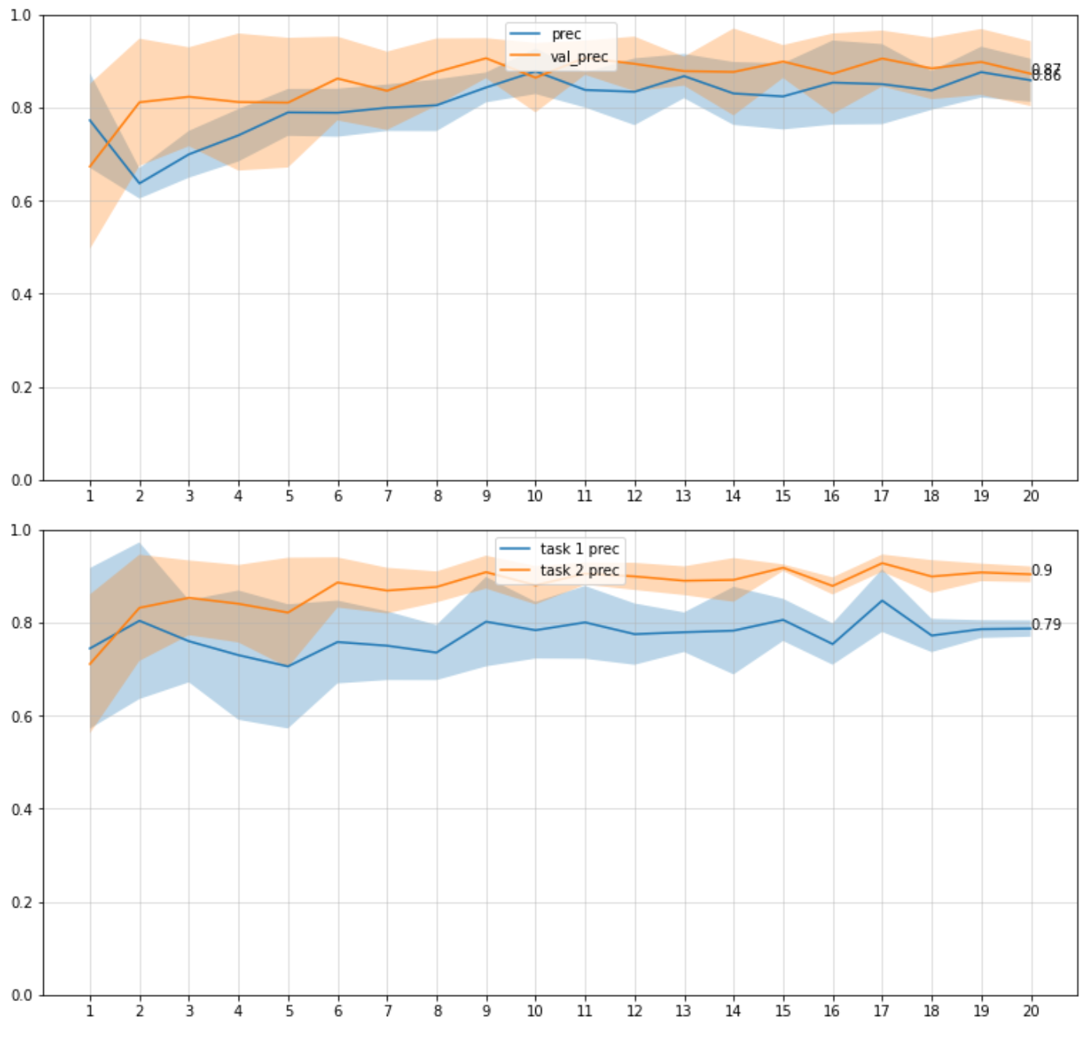
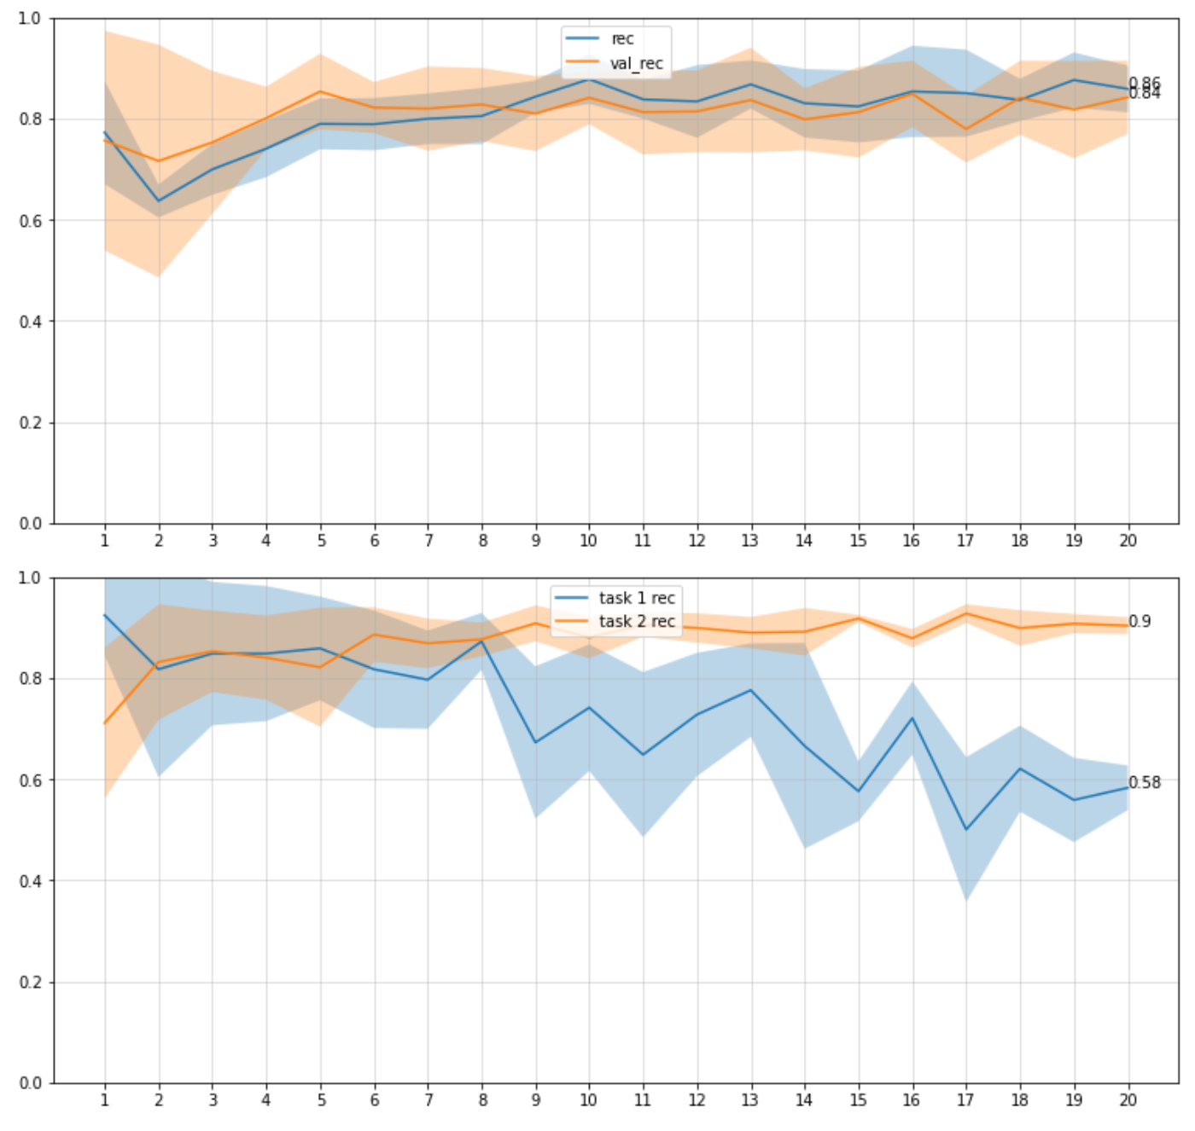
Results - EWC
Task 1 → task 2
Ewc_lambda = 0
Model evaluation
on tasks

Slide 23
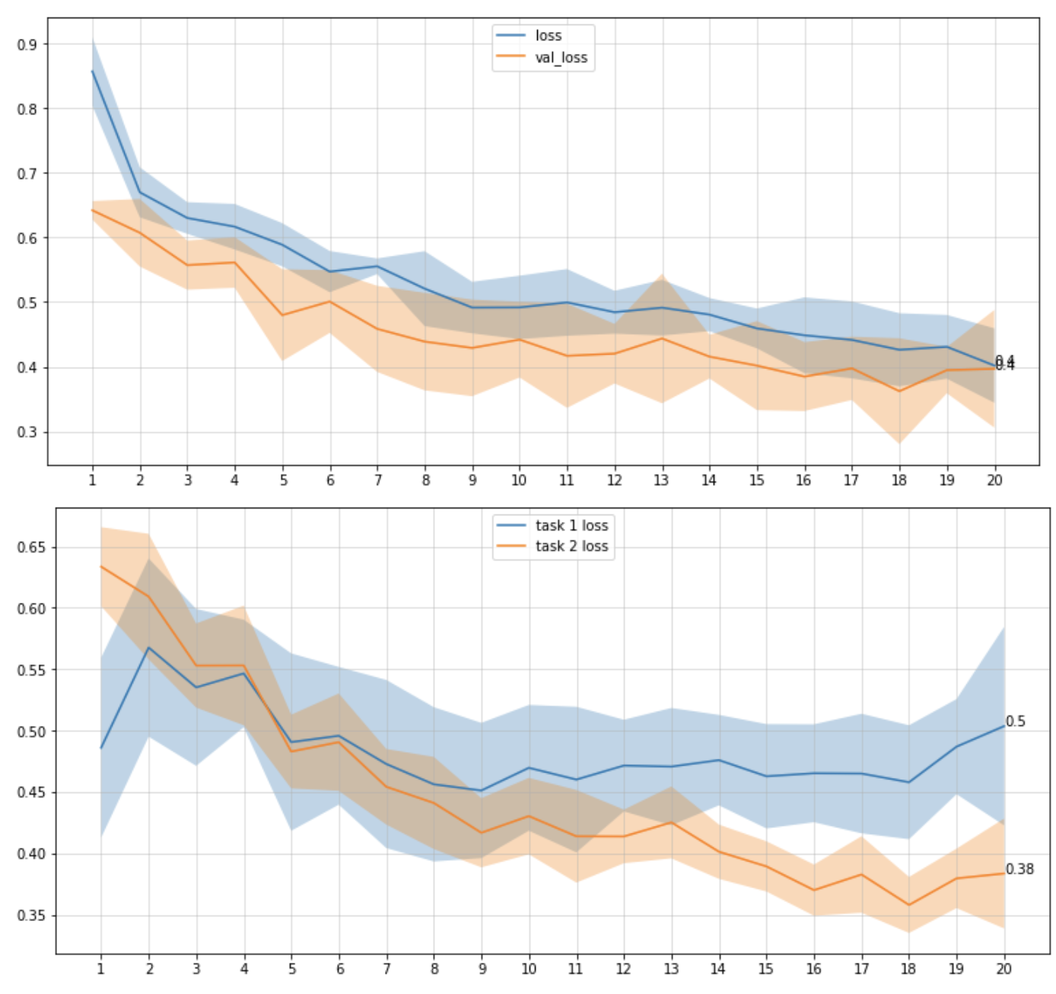
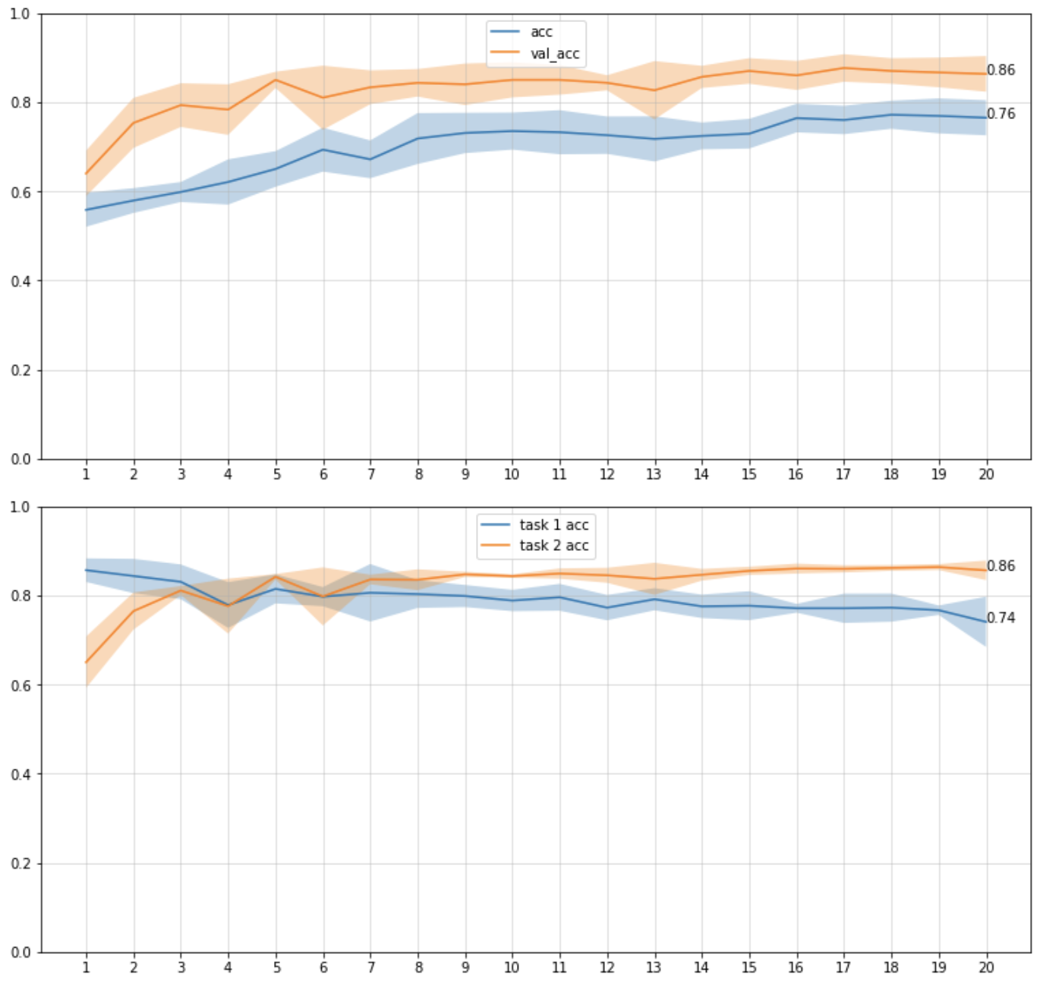
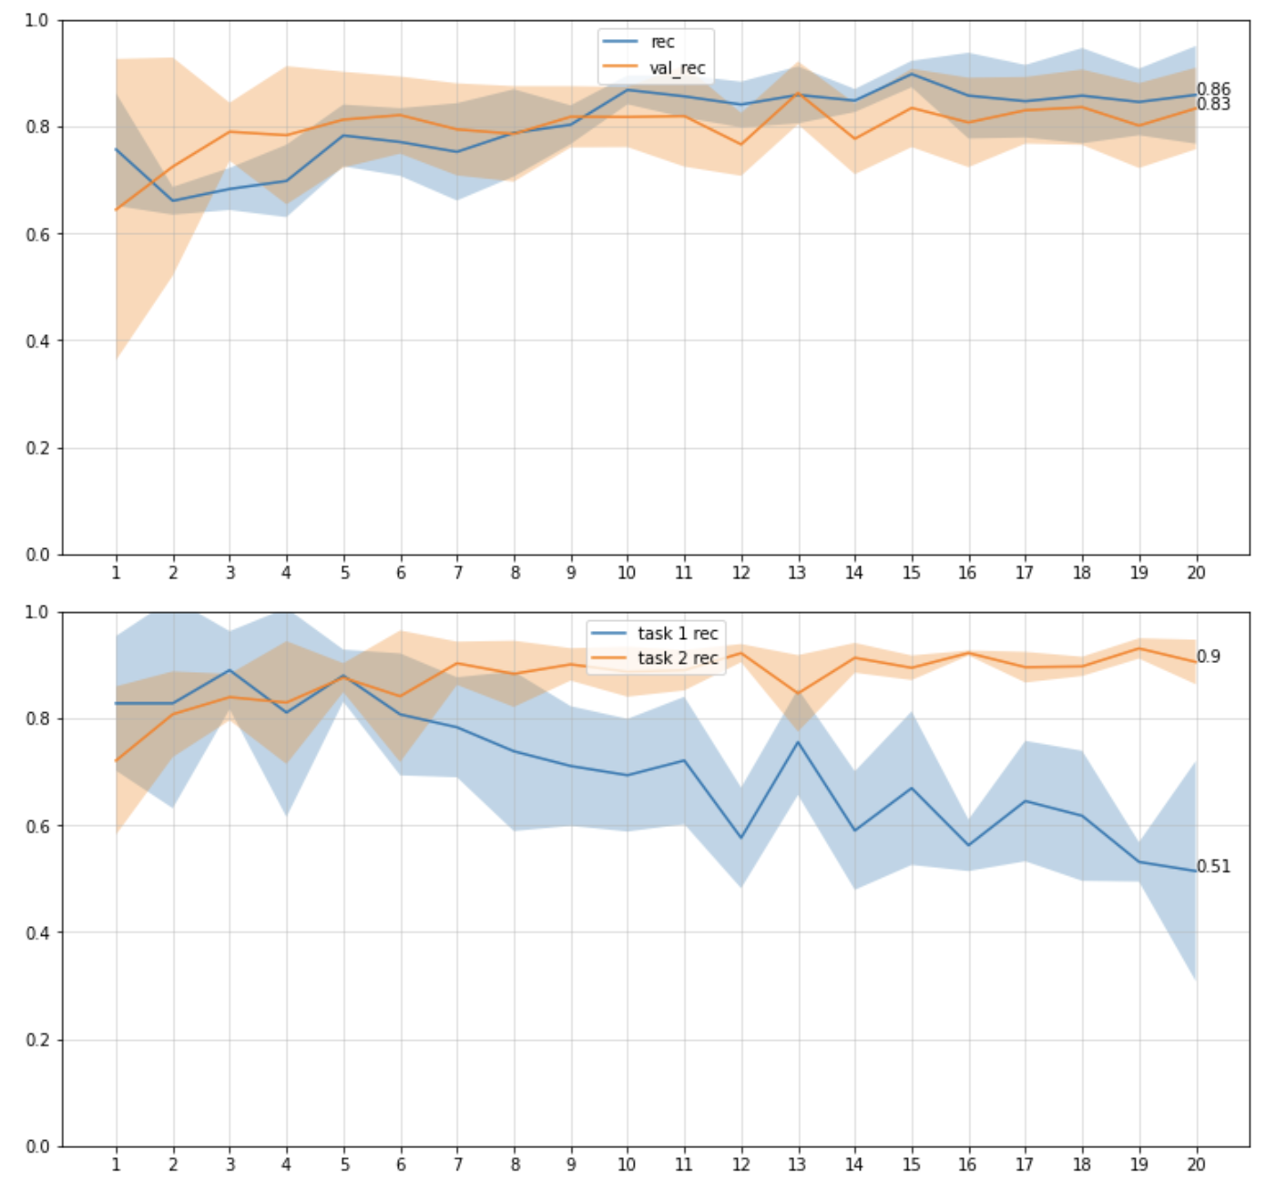
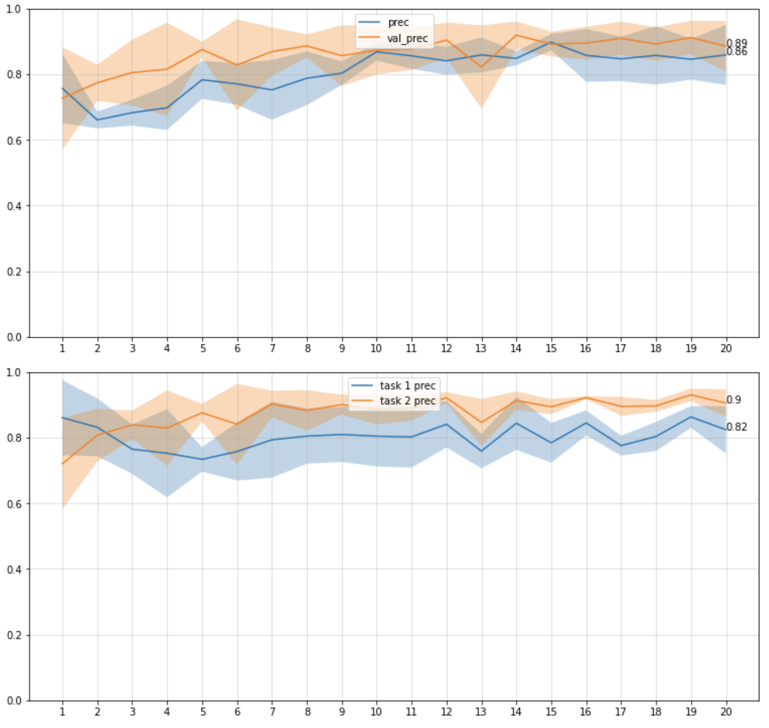
Results - EWC
Task 1 → task 2
Ewc_lambda = 0.7
Model evaluation
on tasks

Slide 24
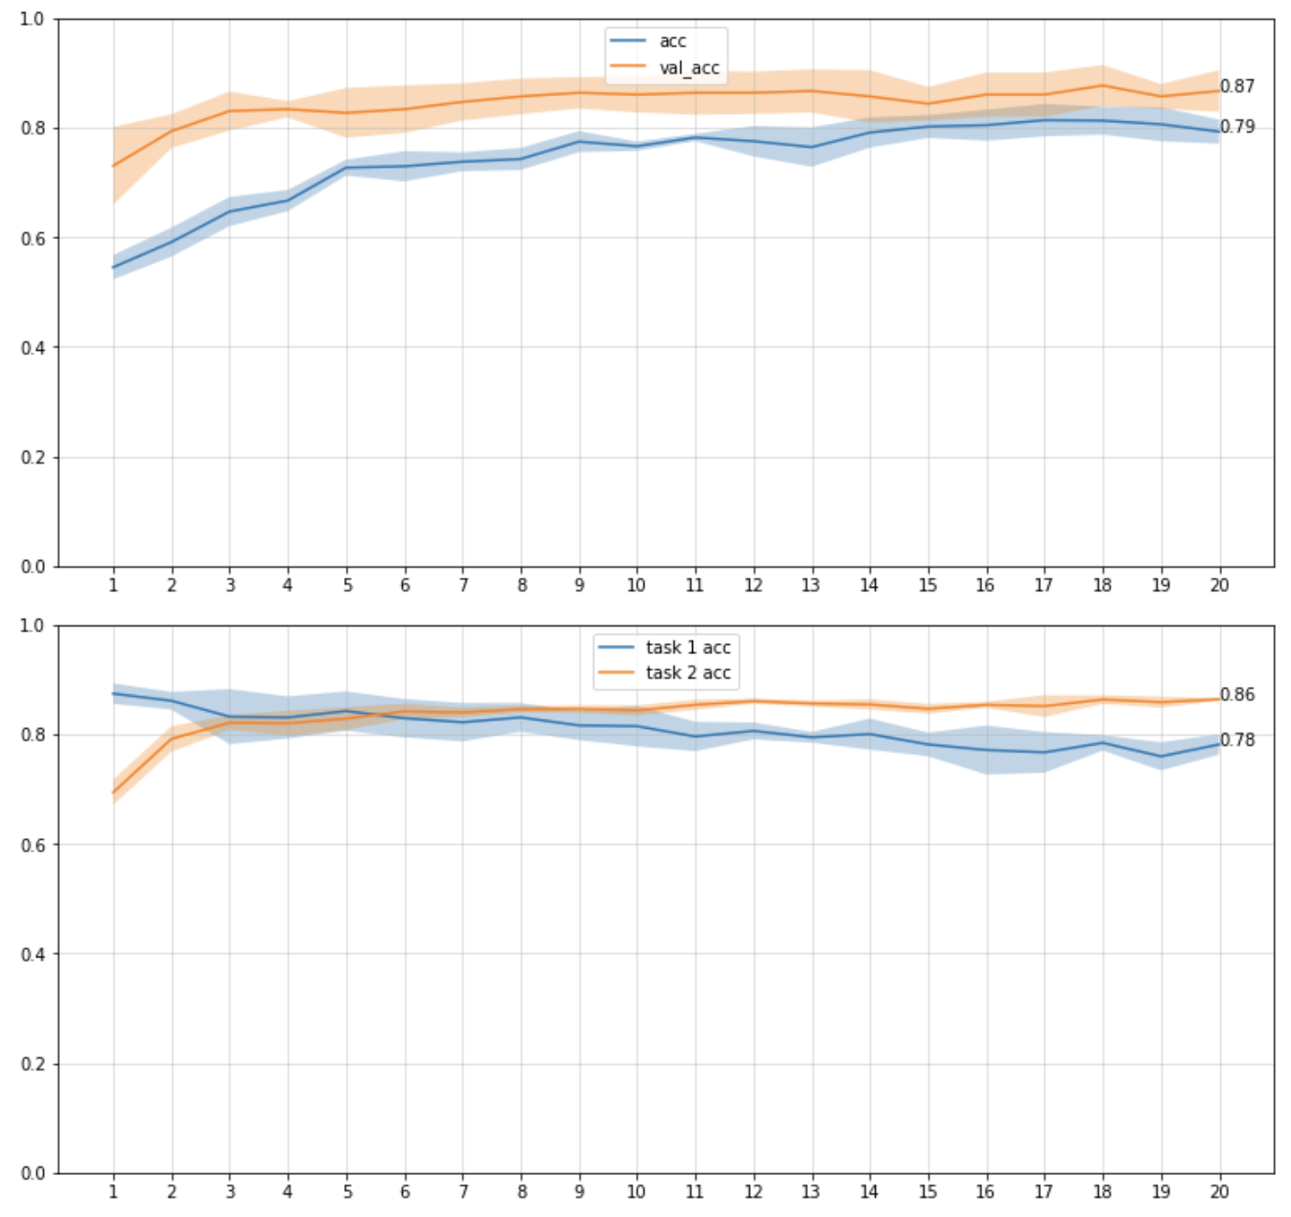
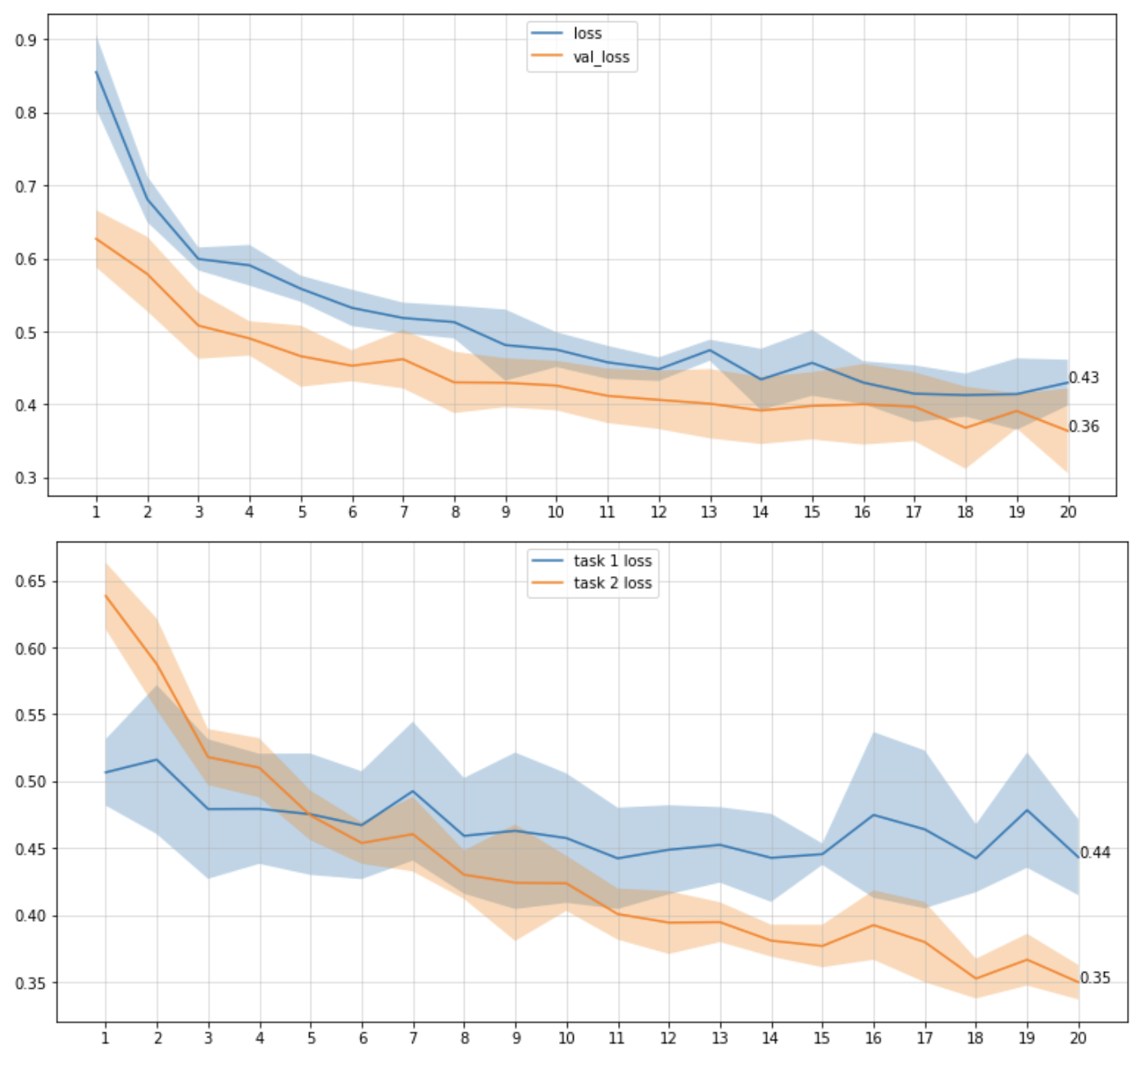
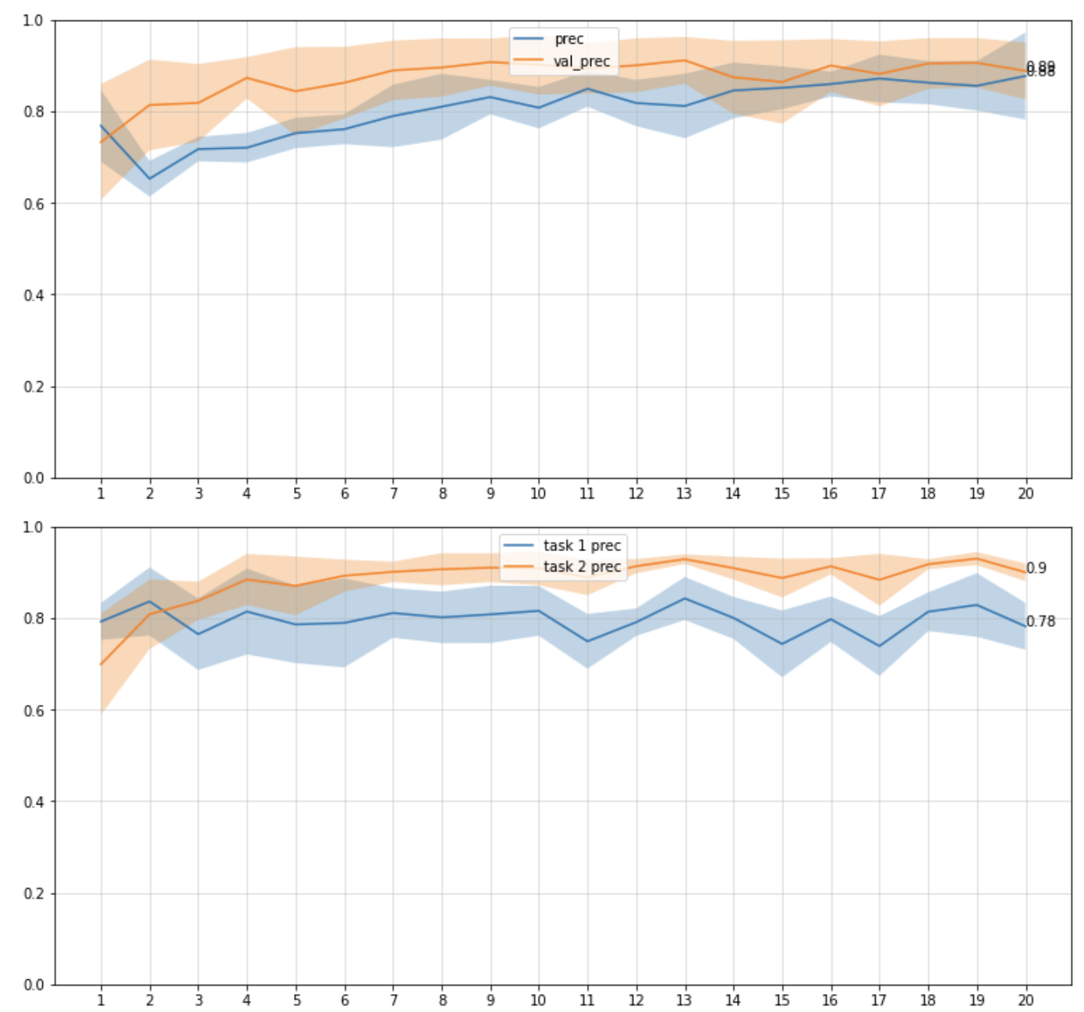
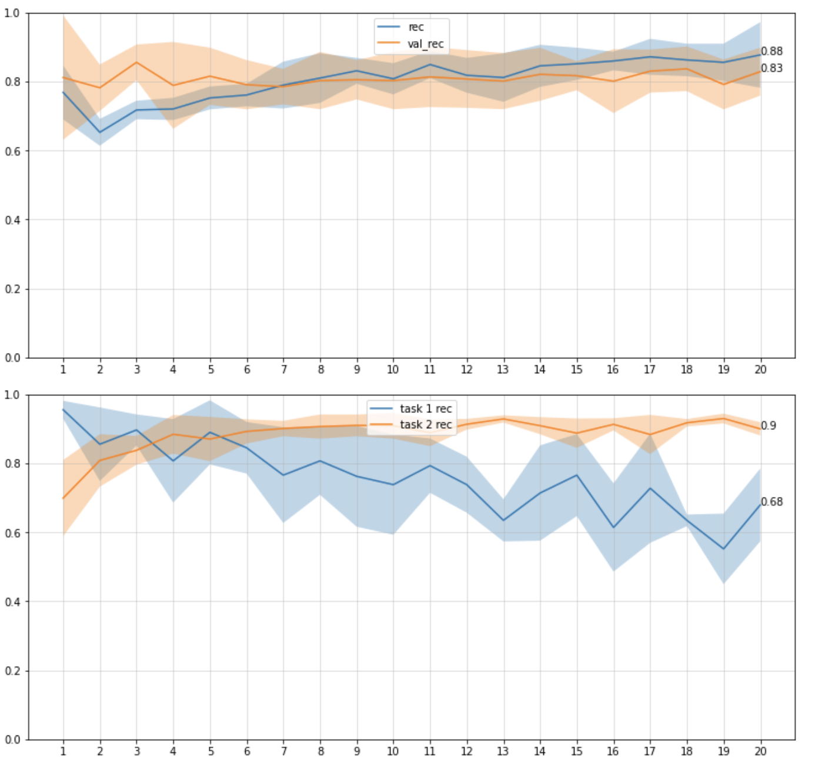
Results - EWC
Task 1 → task 2
Ewc_lambda = 10
Model evaluation
on tasks

Slide 25
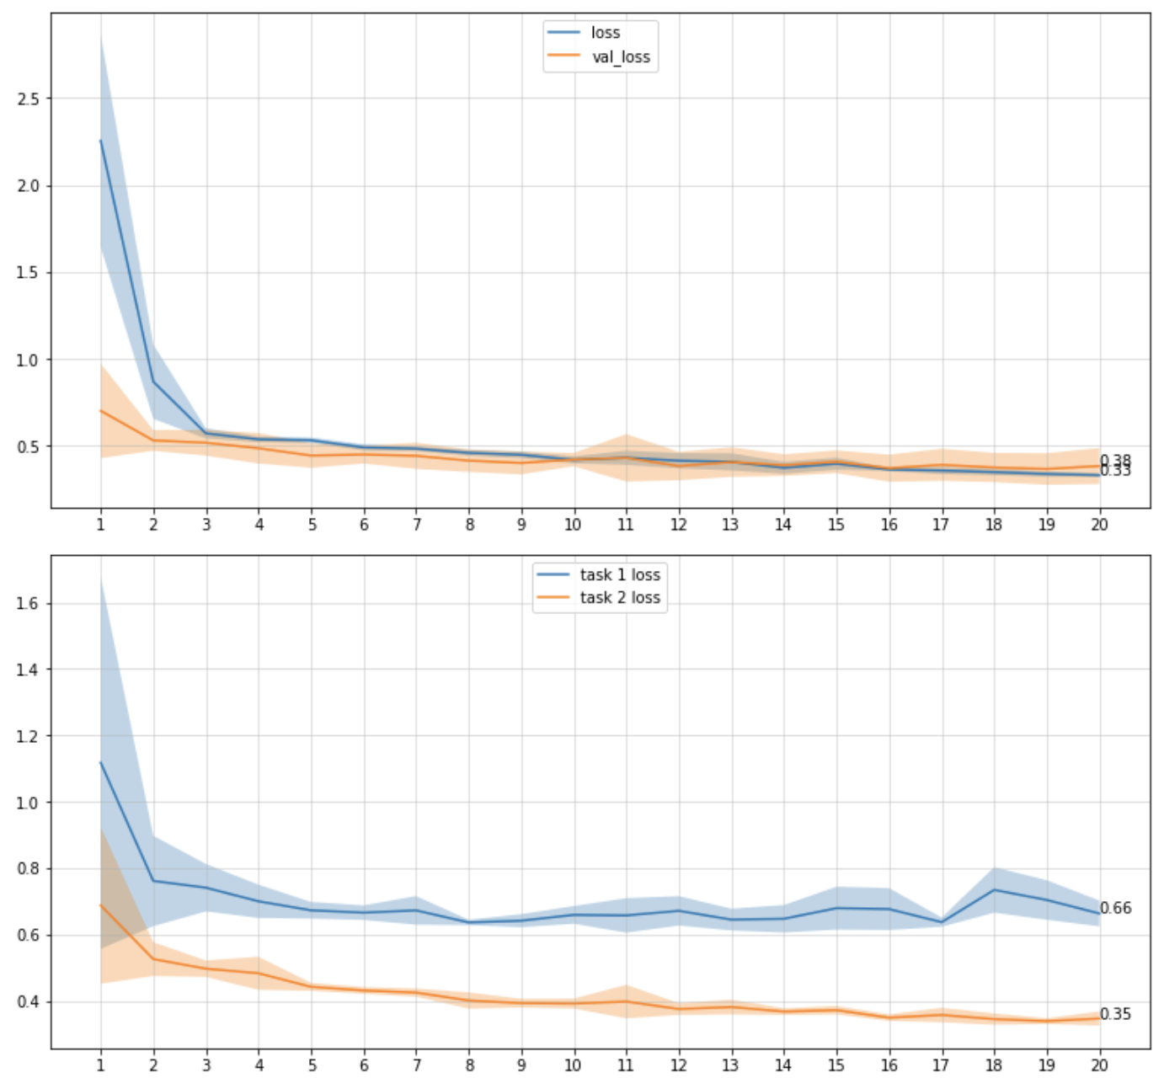
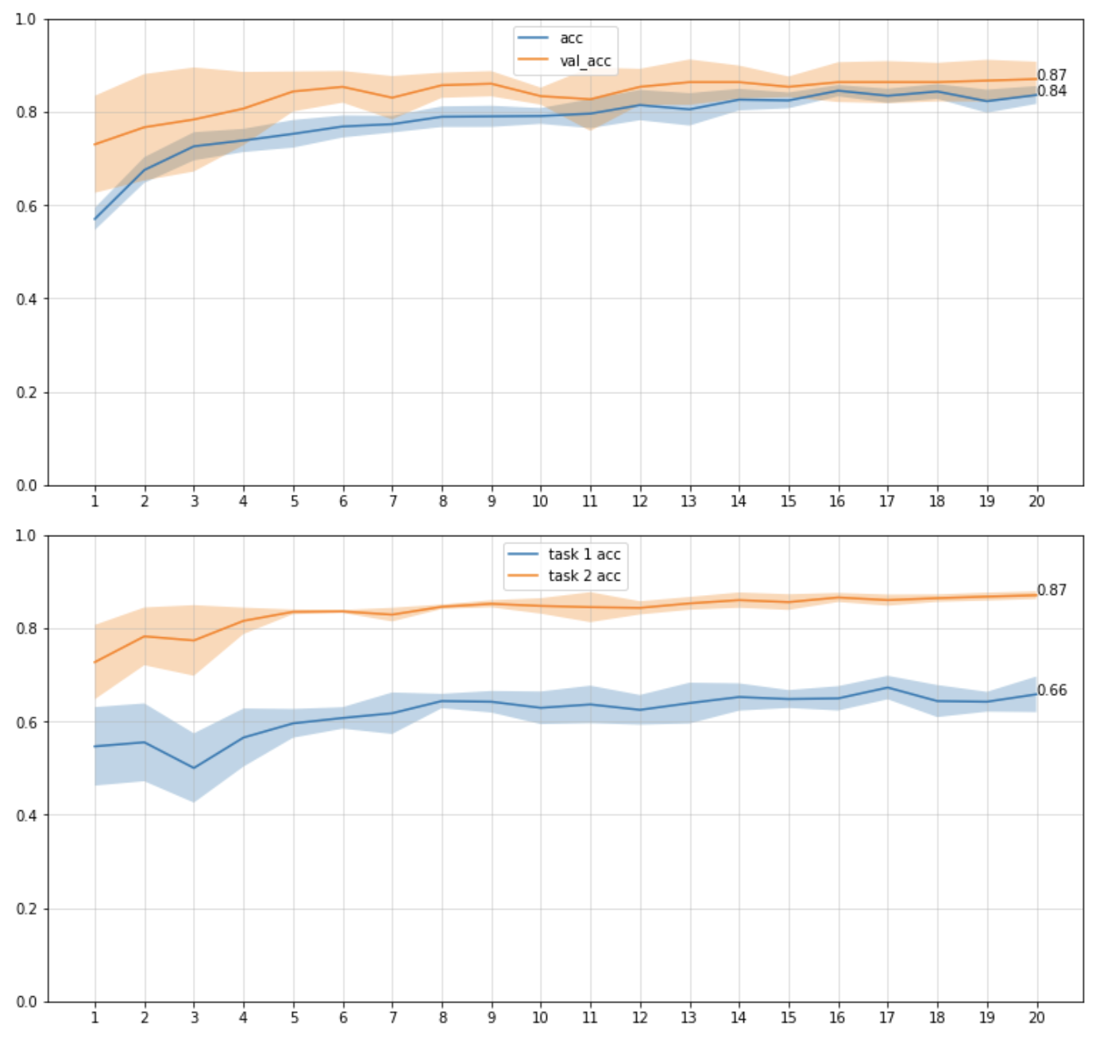
Task 2 → Shenzhen dataset Task 3 → Stanford dataset
Results - EWC
Task 2 only
Model evaluation
on tasks

Slide 26
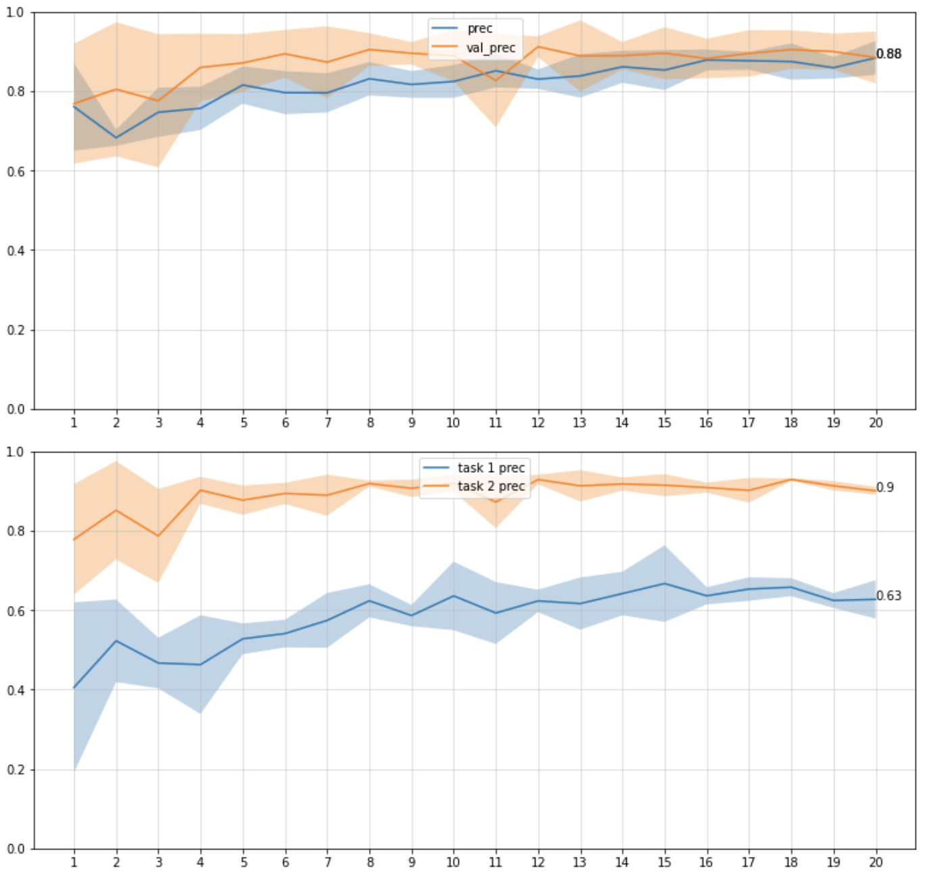
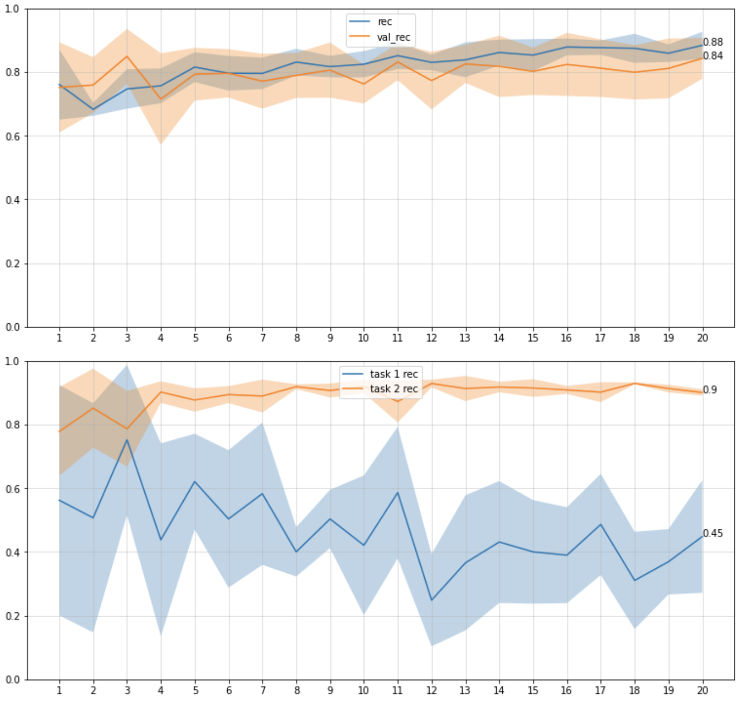
Task 2 → Shenzhen dataset Task 3 → Stanford dataset
Results - EWC
Task 2 only
Model evaluation
on tasks

Slide 27
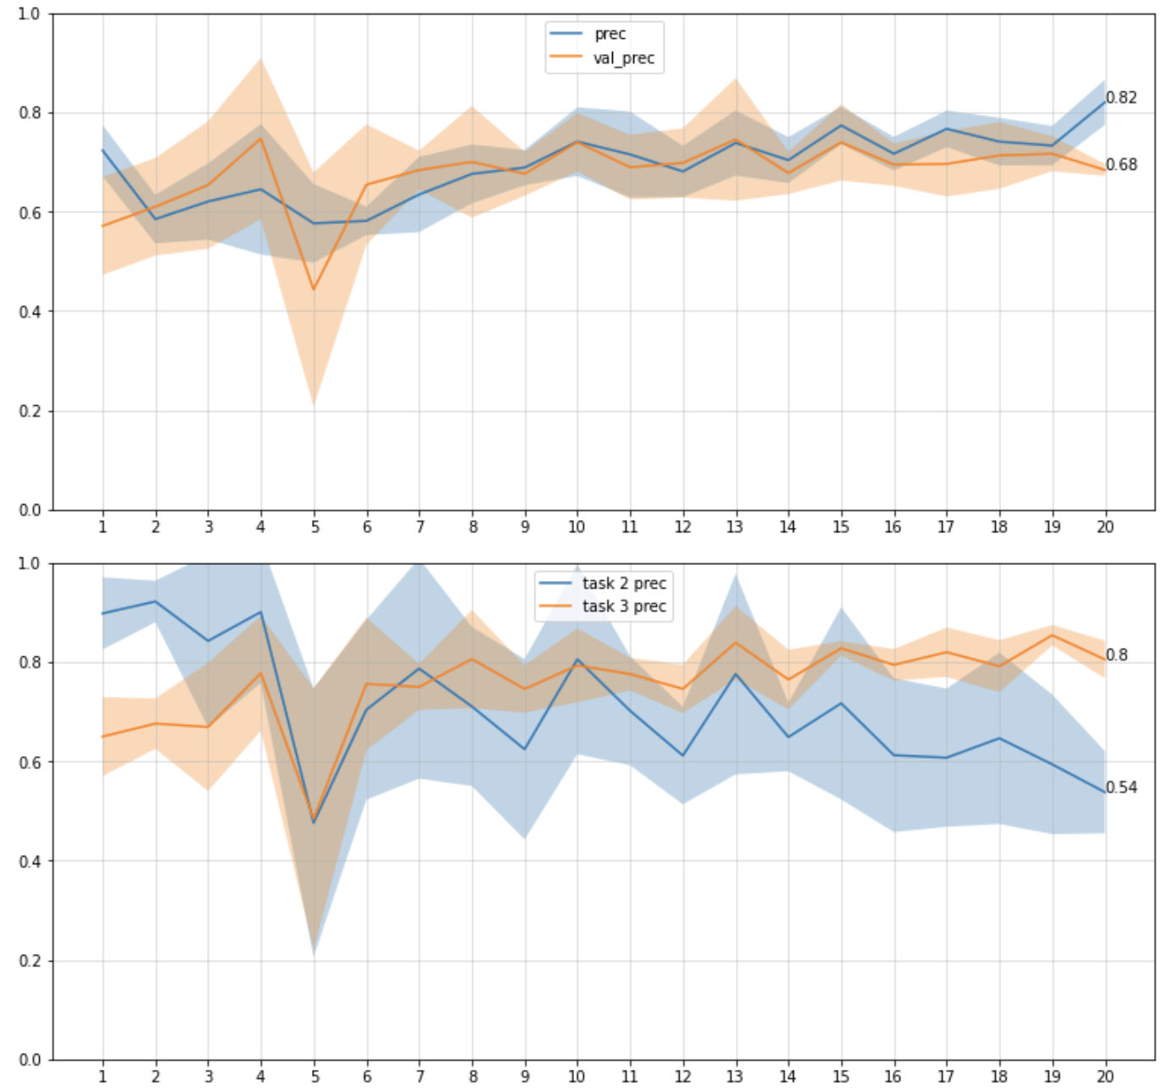
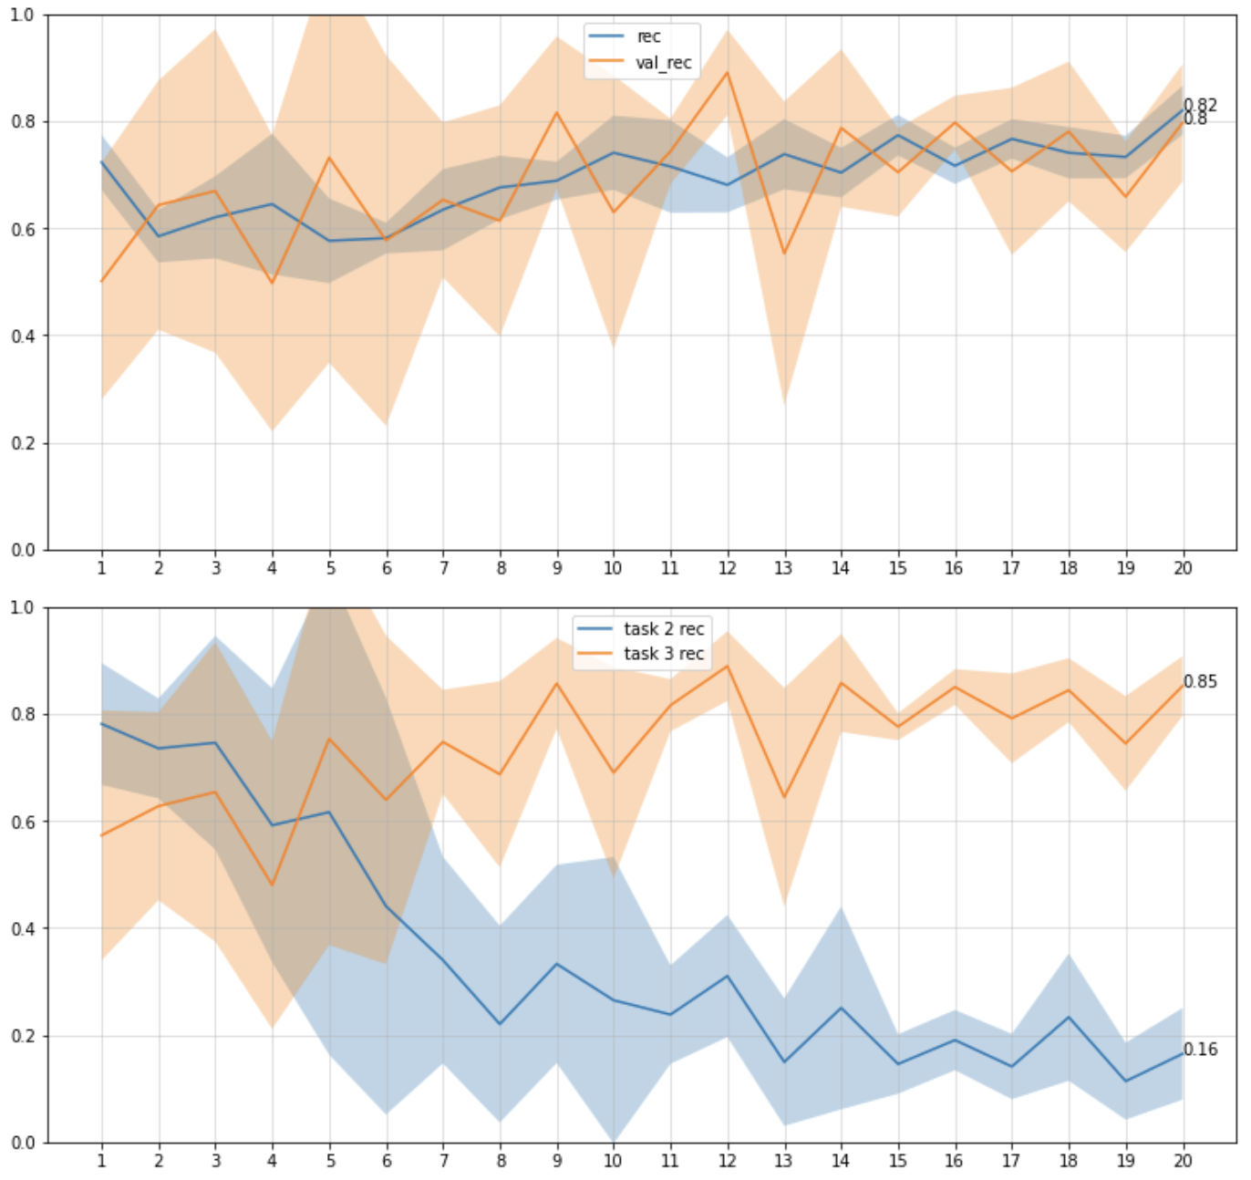
Task 2 → Shenzhen dataset Task 3 → Stanford dataset
Results - EWC
Task 2 → task 3 Ewc_lambda = 0
Task 2 only

Slide 28
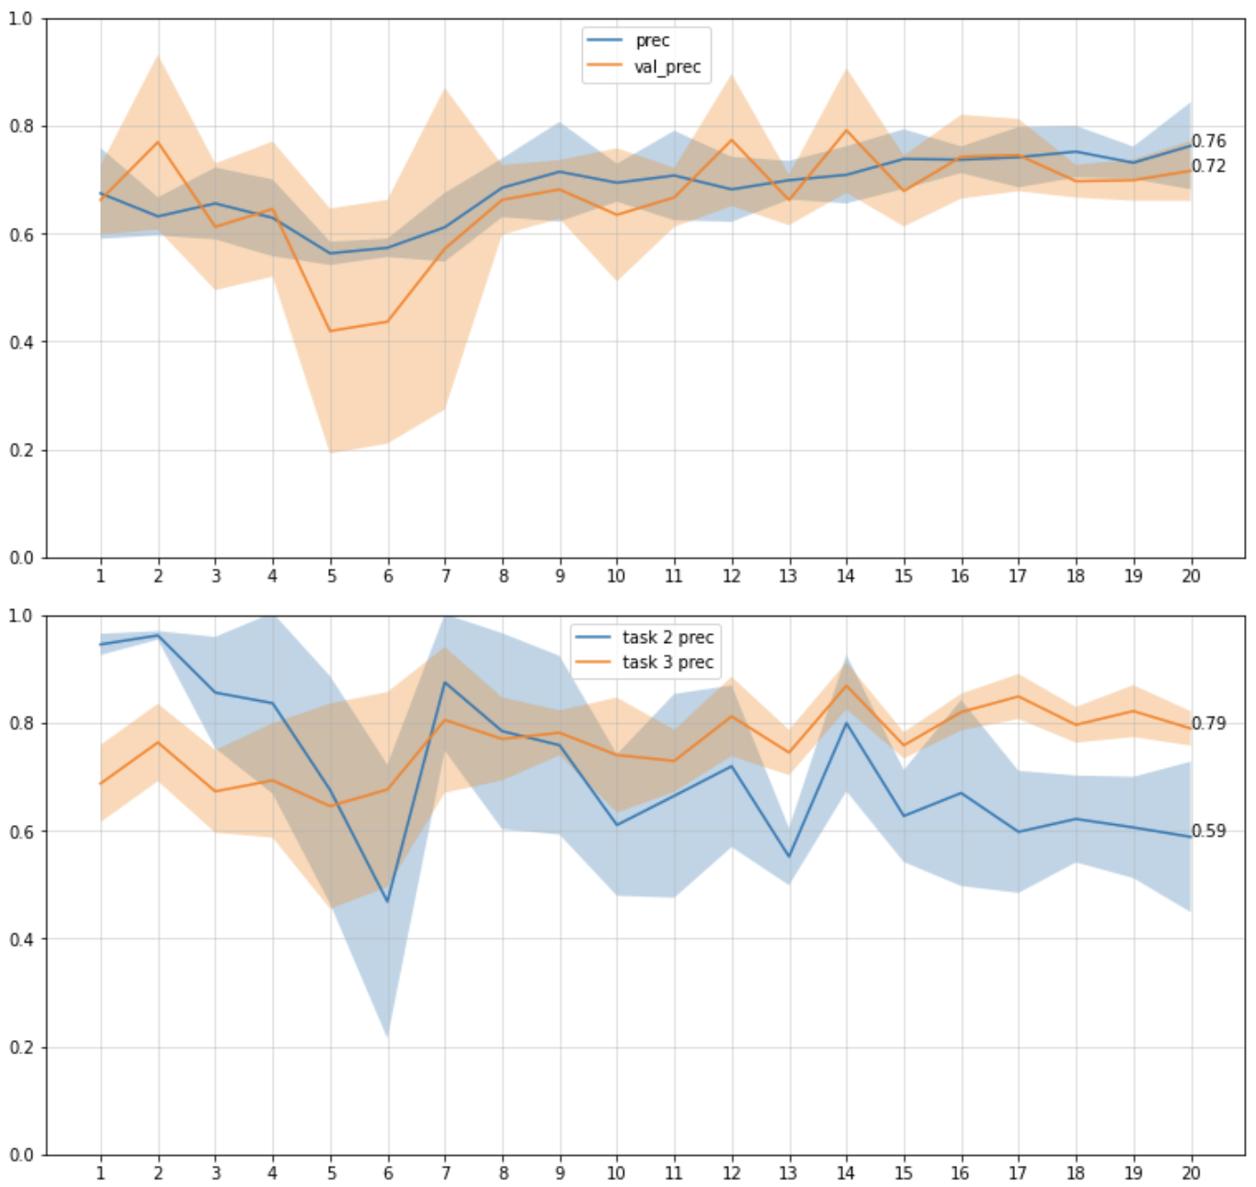
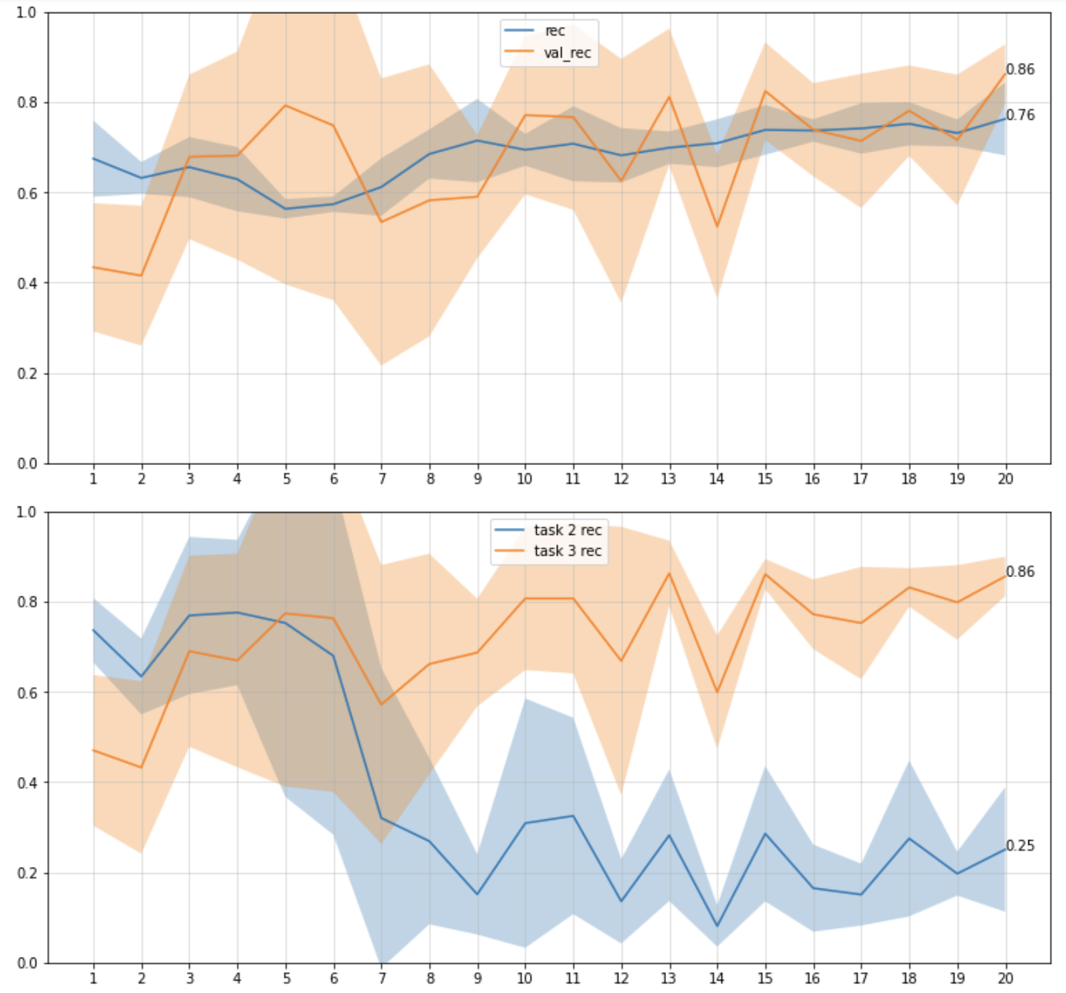
Task 2 → Shenzhen dataset Task 3 → Stanford dataset
Results - EWC
Task 2 → task 3 Ewc_lambda = 0.7
Task 2 only

Slide 29
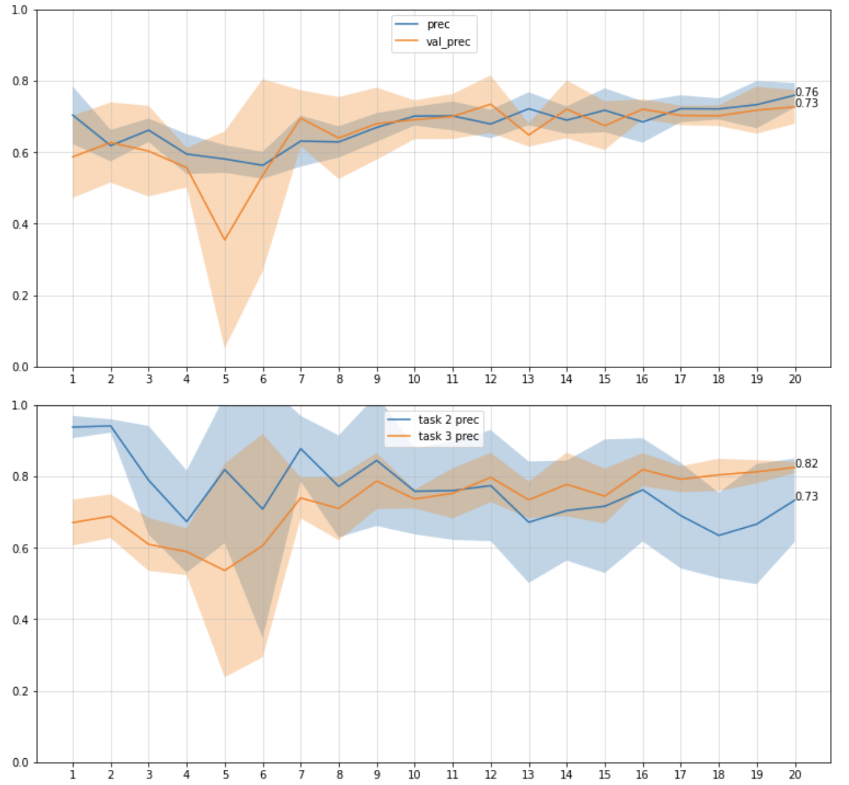
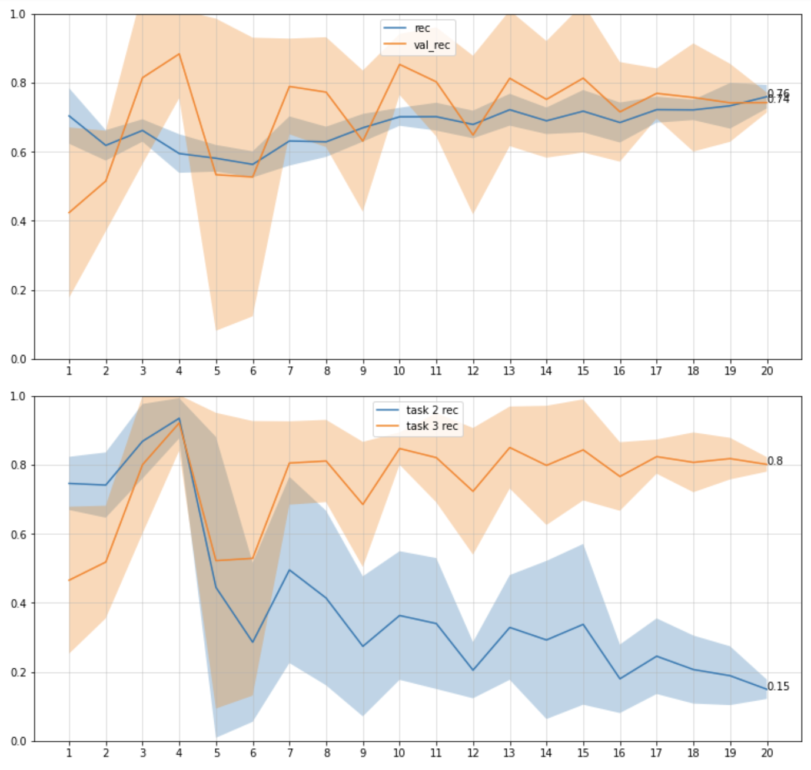
Task 2 → Shenzhen dataset Task 3 → Stanford dataset
Results - EWC
Task 2 → task 3 Ewc_lambda = 10
Task 2 only

Slide 30
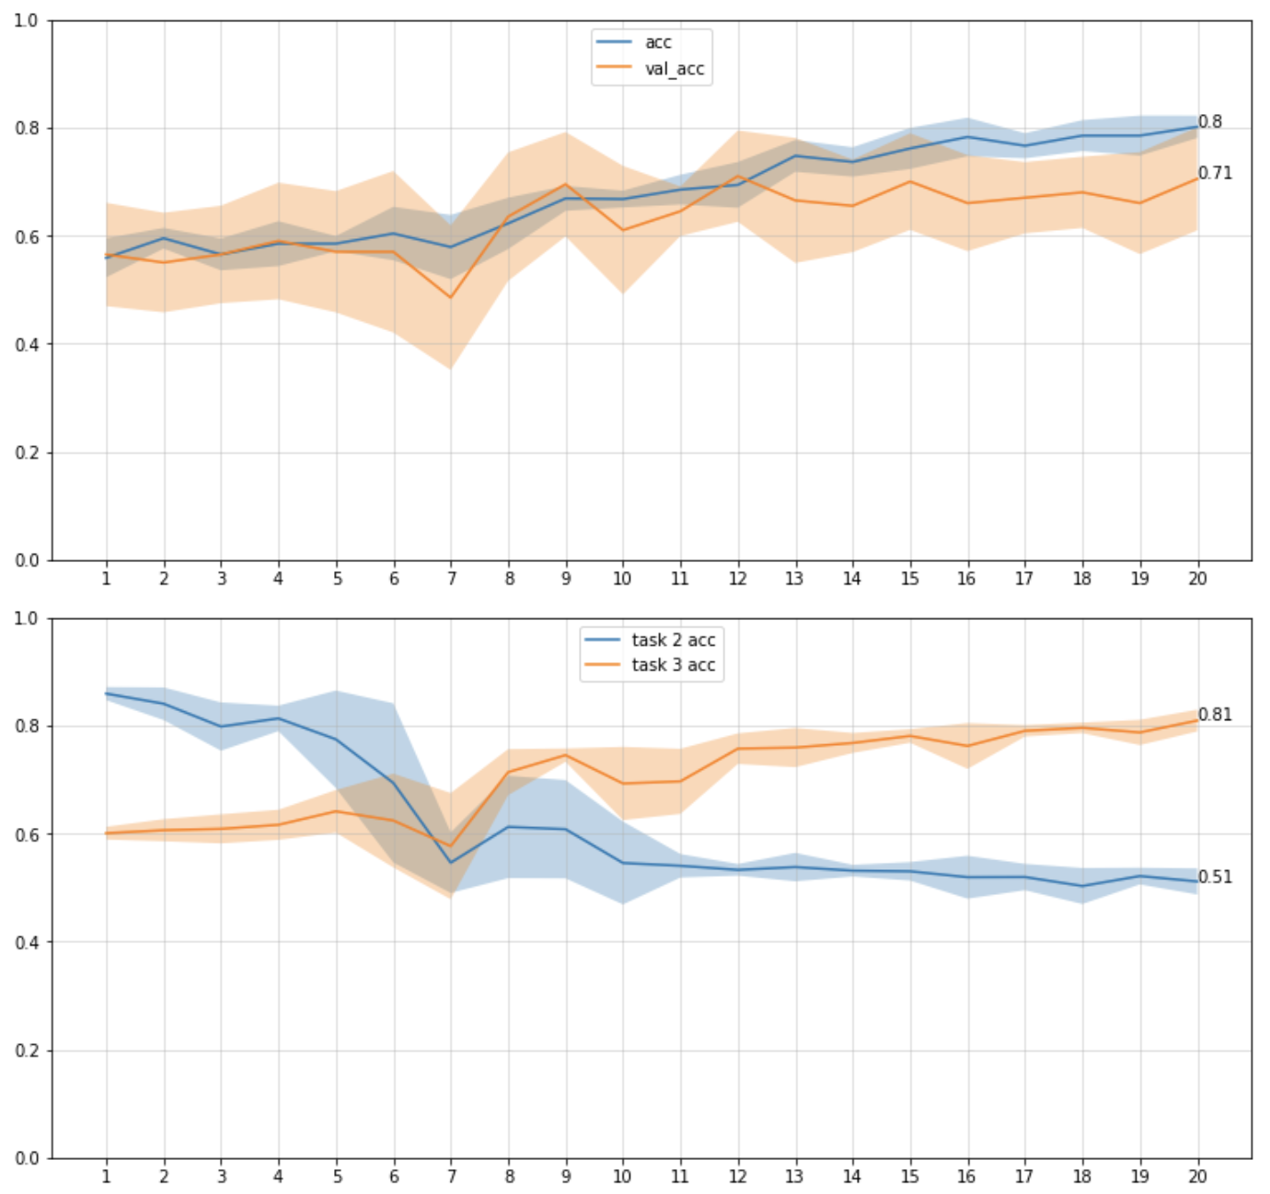
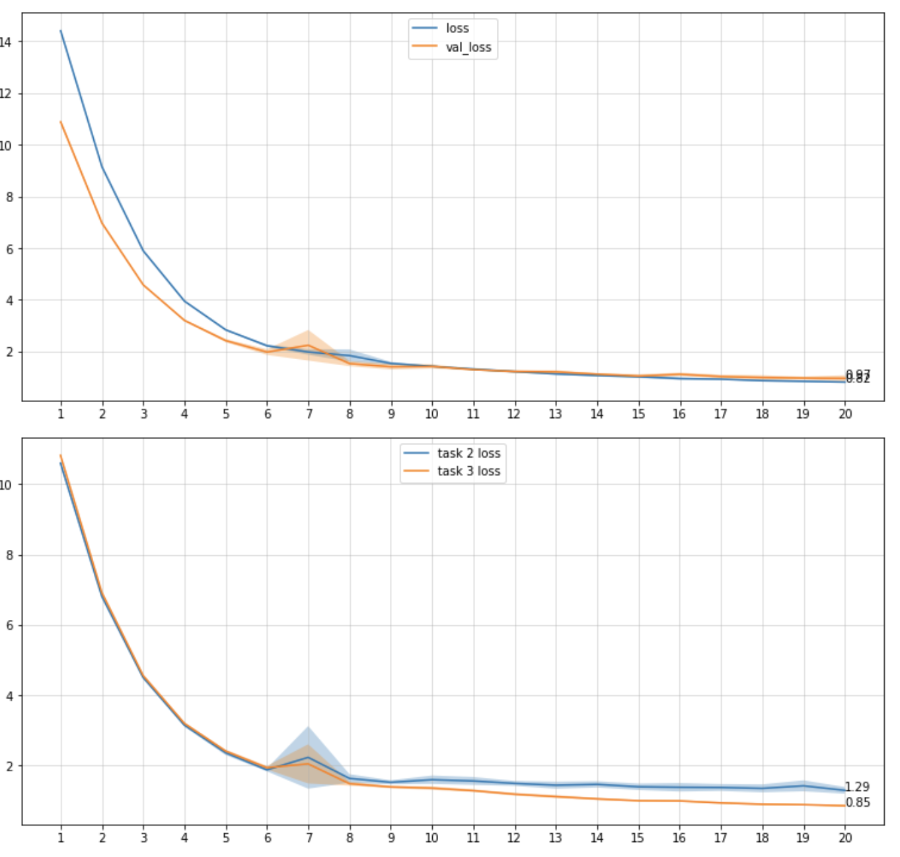
Task 2 → Shenzhen dataset Task 3 → Stanford dataset
Results - EWC
Task 2 → task 3
Ewc_lambda = 0
Model evaluation
on tasks

Slide 31
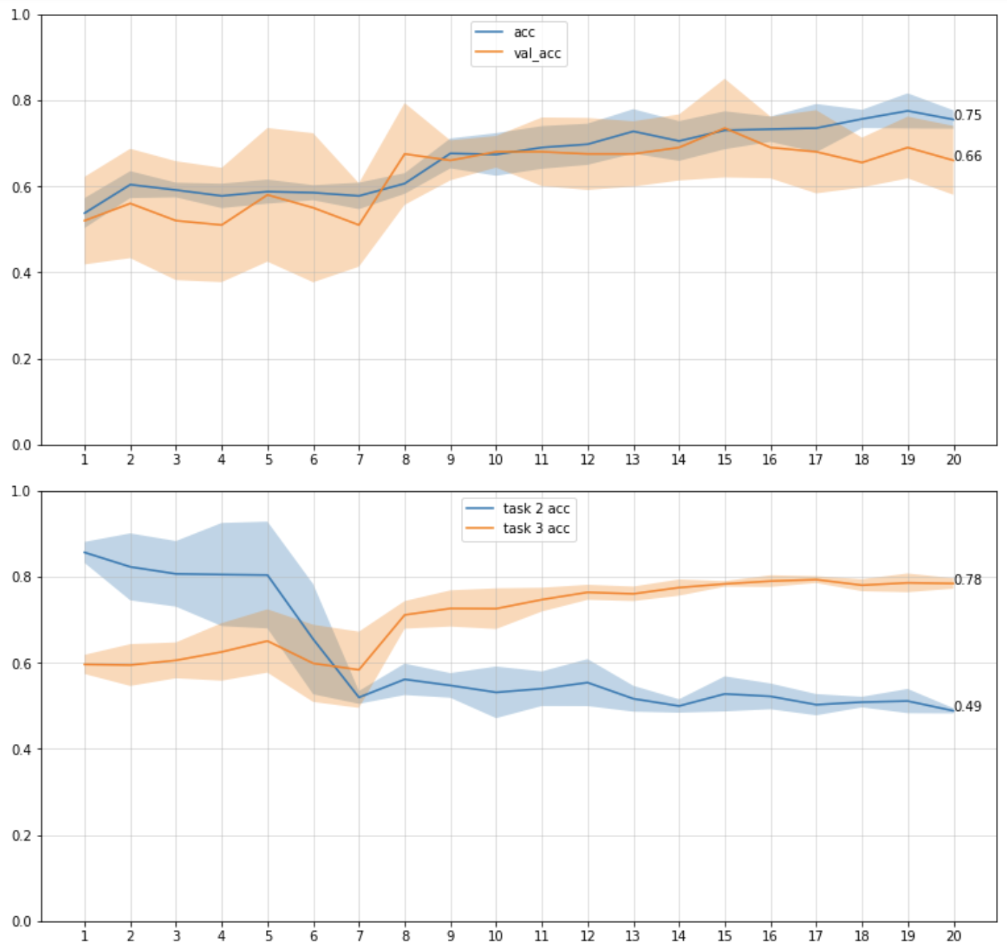
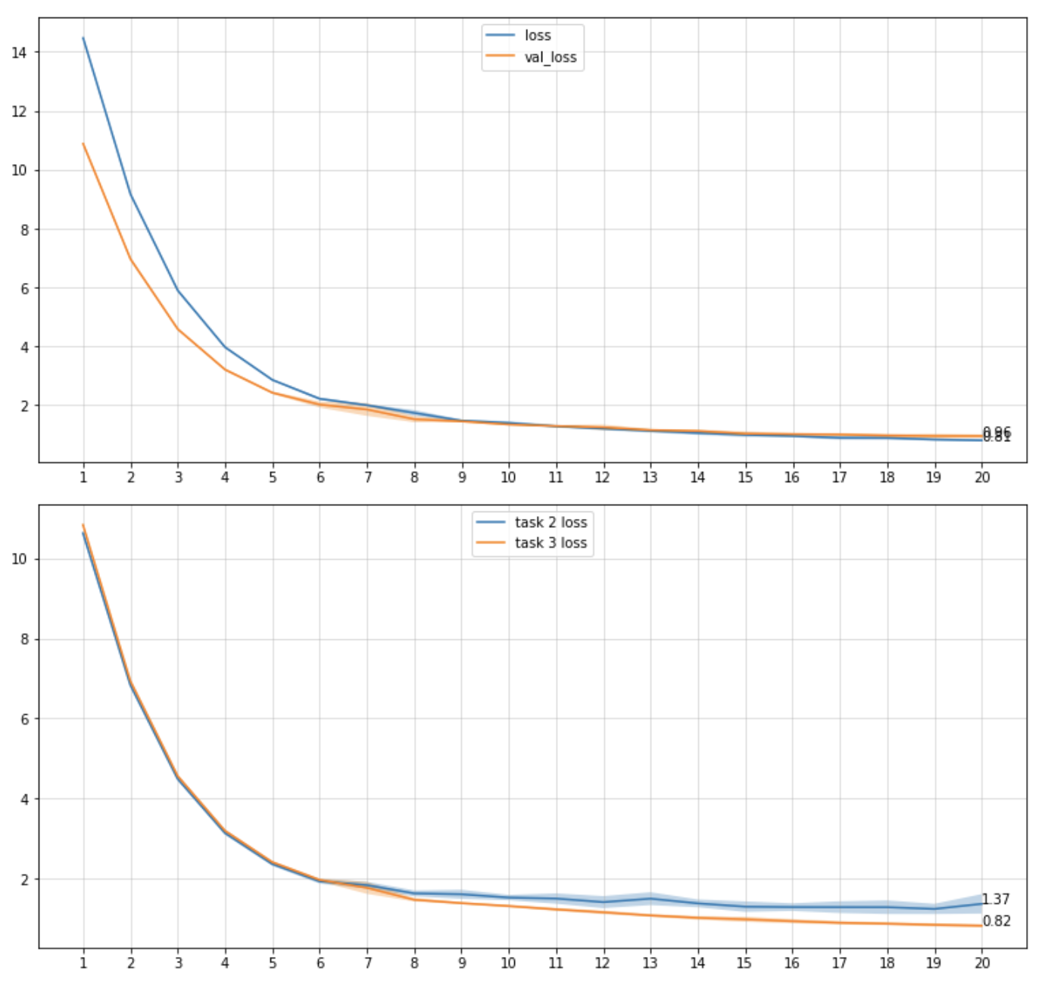
Task 2 → Shenzhen dataset Task 3 → Stanford dataset
Results - EWC
Task 2 → task 3
Ewc_lambda = 0.7
Model evaluation
on tasks

Slide 32
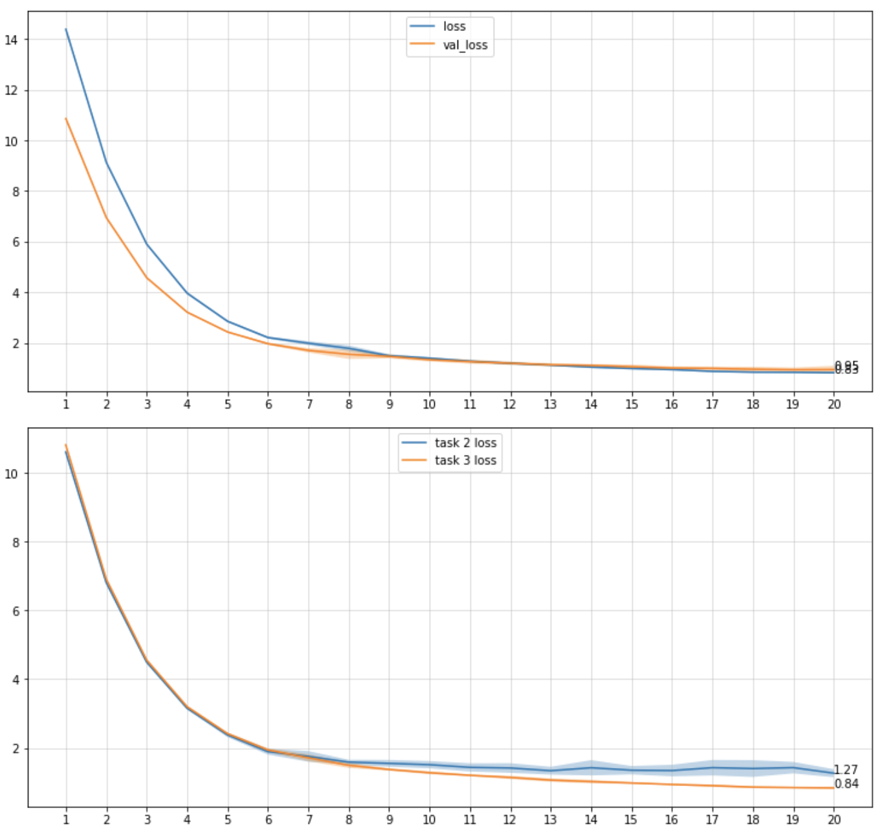
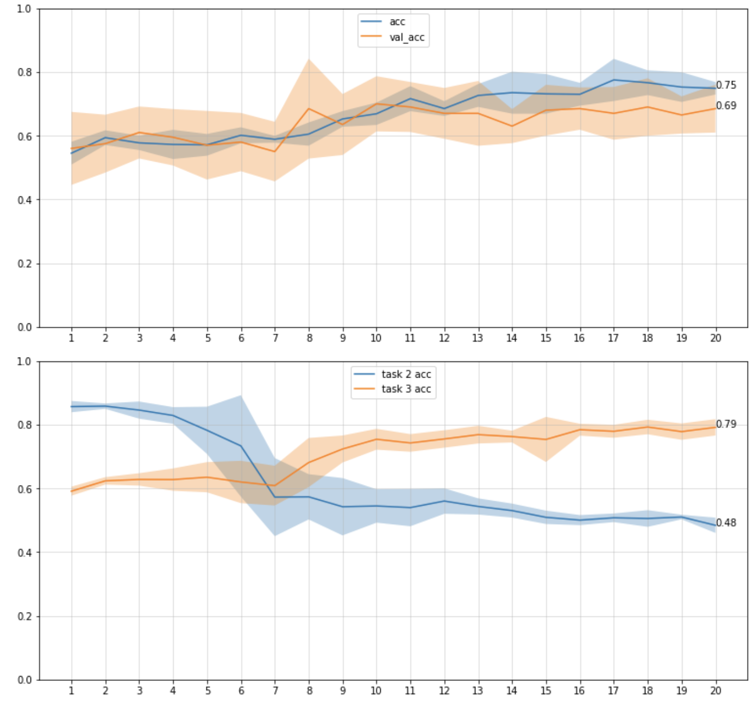
Task 2 → Shenzhen dataset Task 3 → Stanford dataset
Results - EWC
Task 2 → task 3
Ewc_lambda = 10
Model evaluation
on tasks

Slide 33
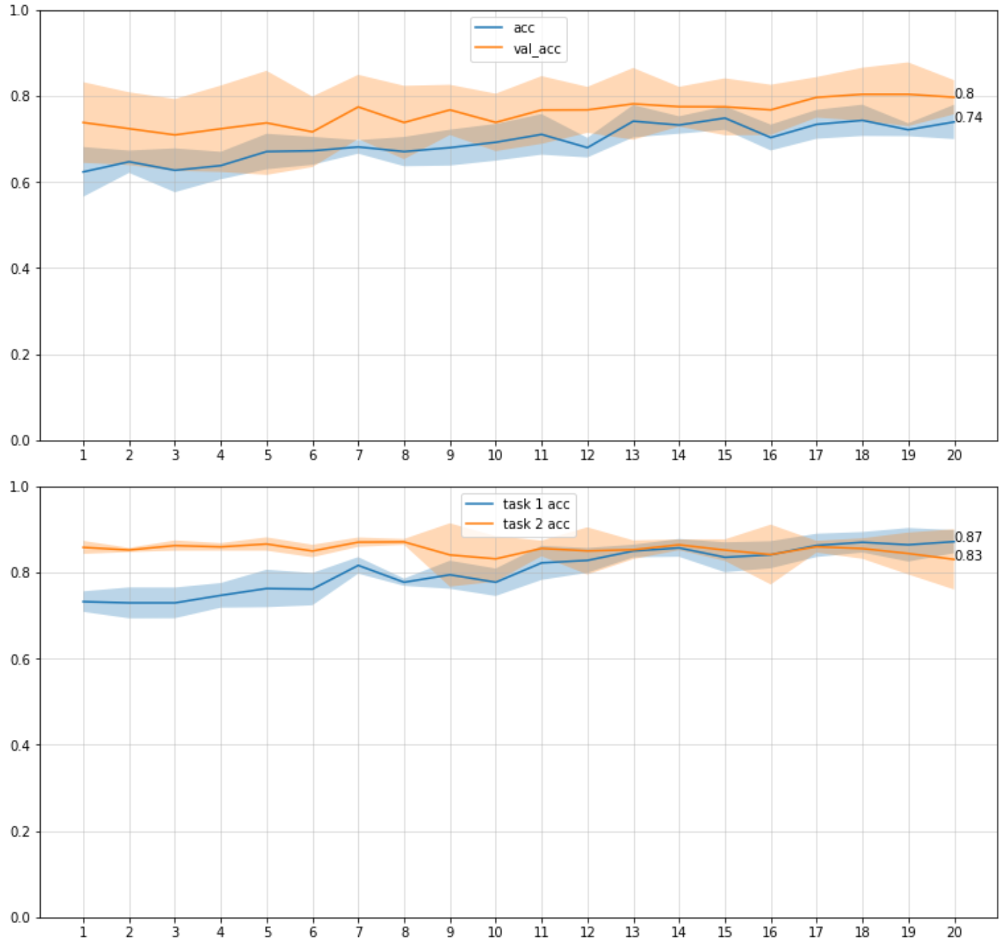
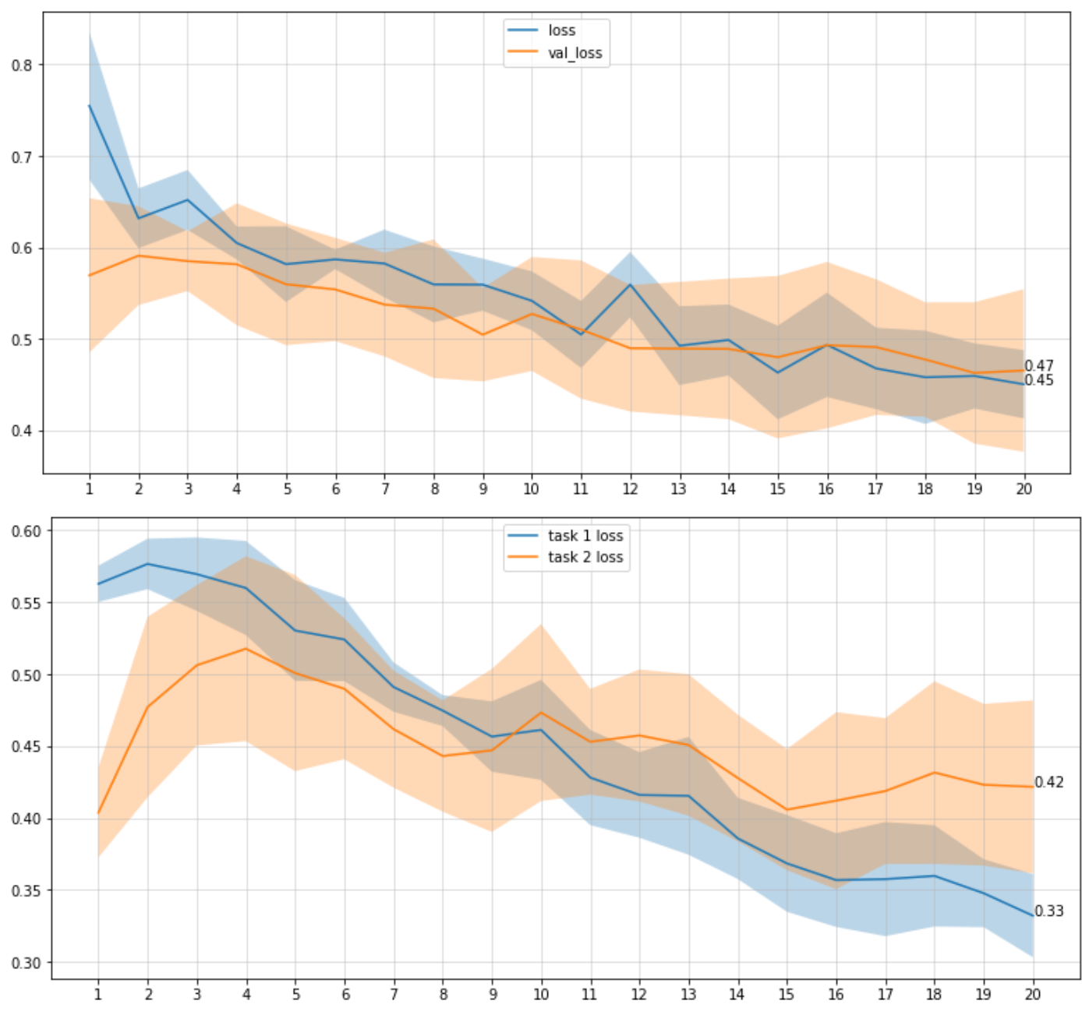
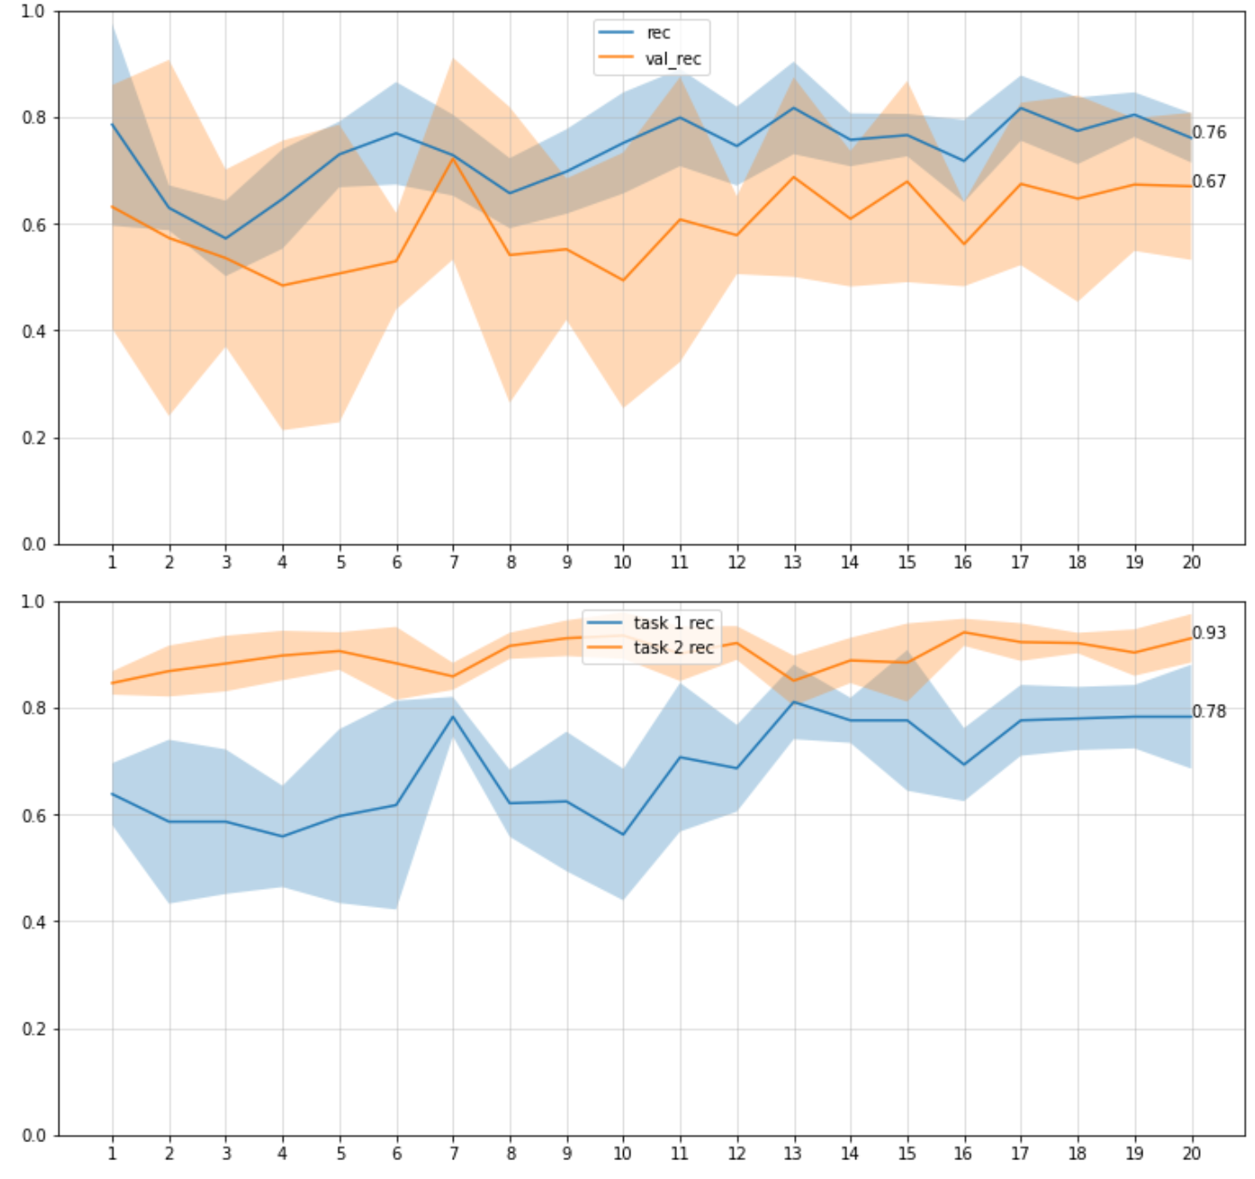
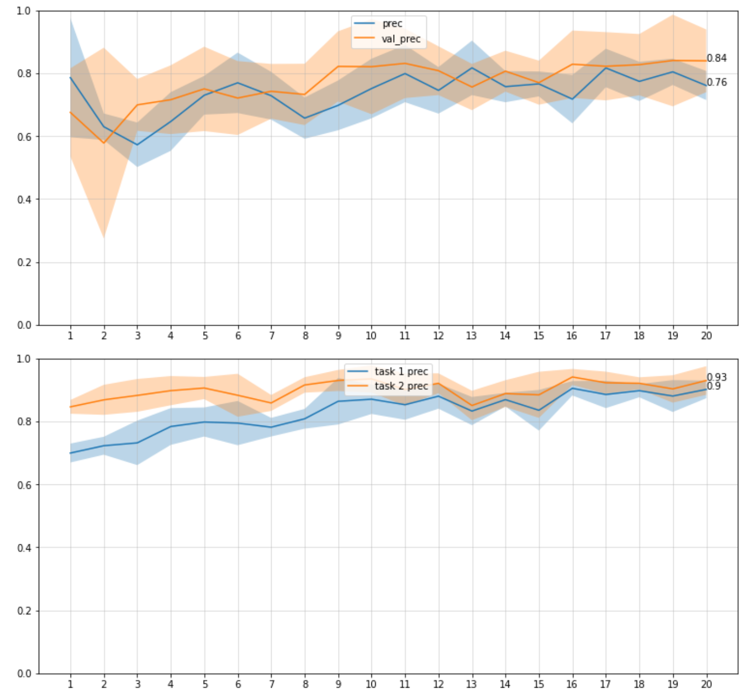
Results - EWC
Task 2 → task 1
Ewc_lambda = 0
Model evaluation
on tasks

Slide 34
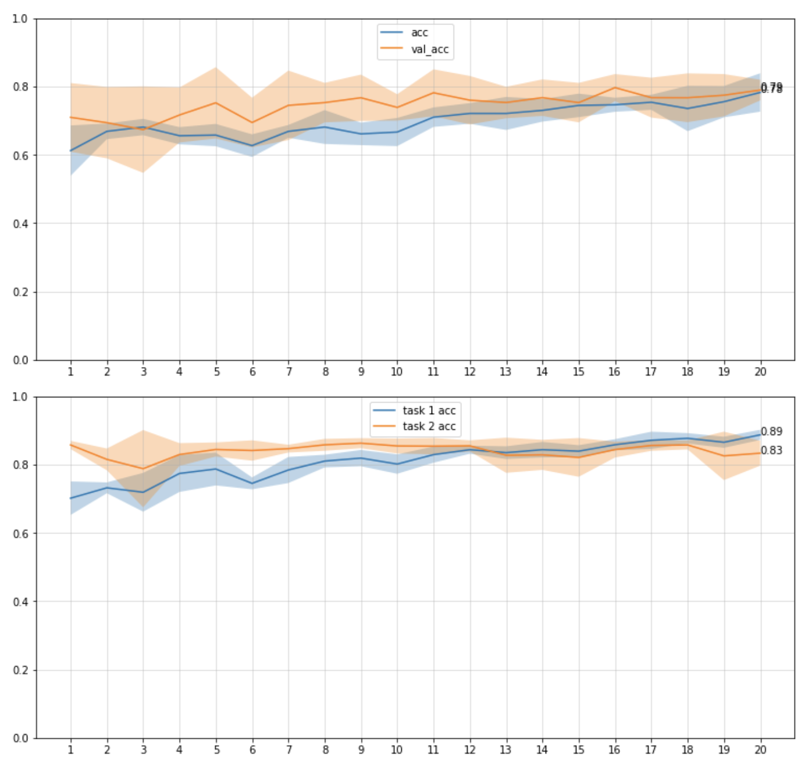
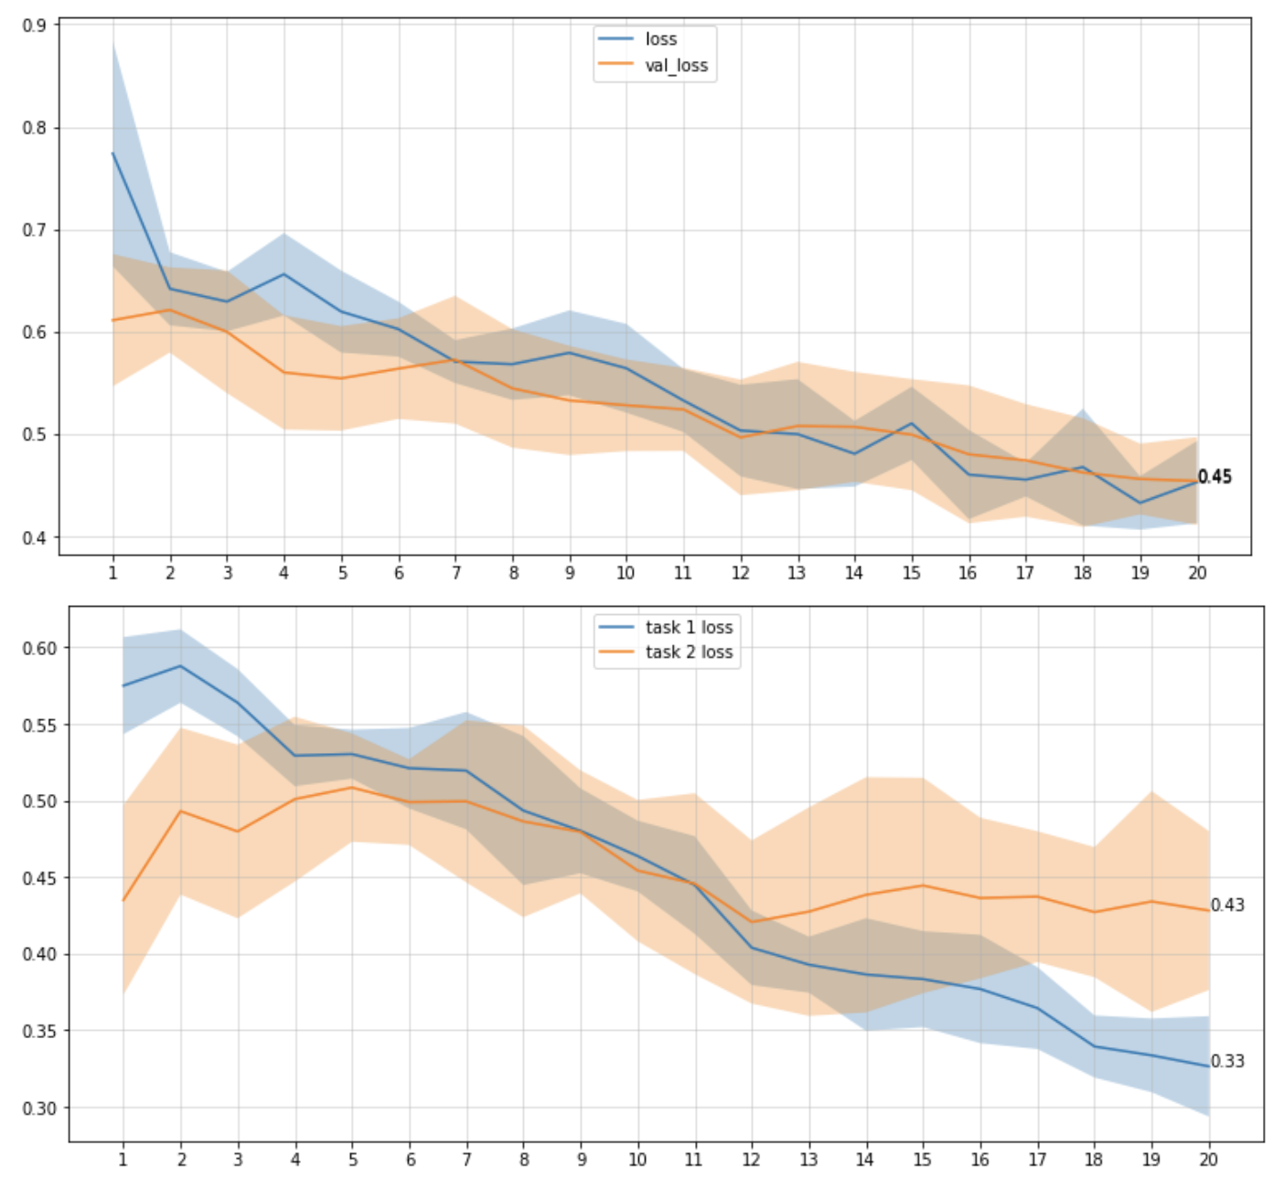
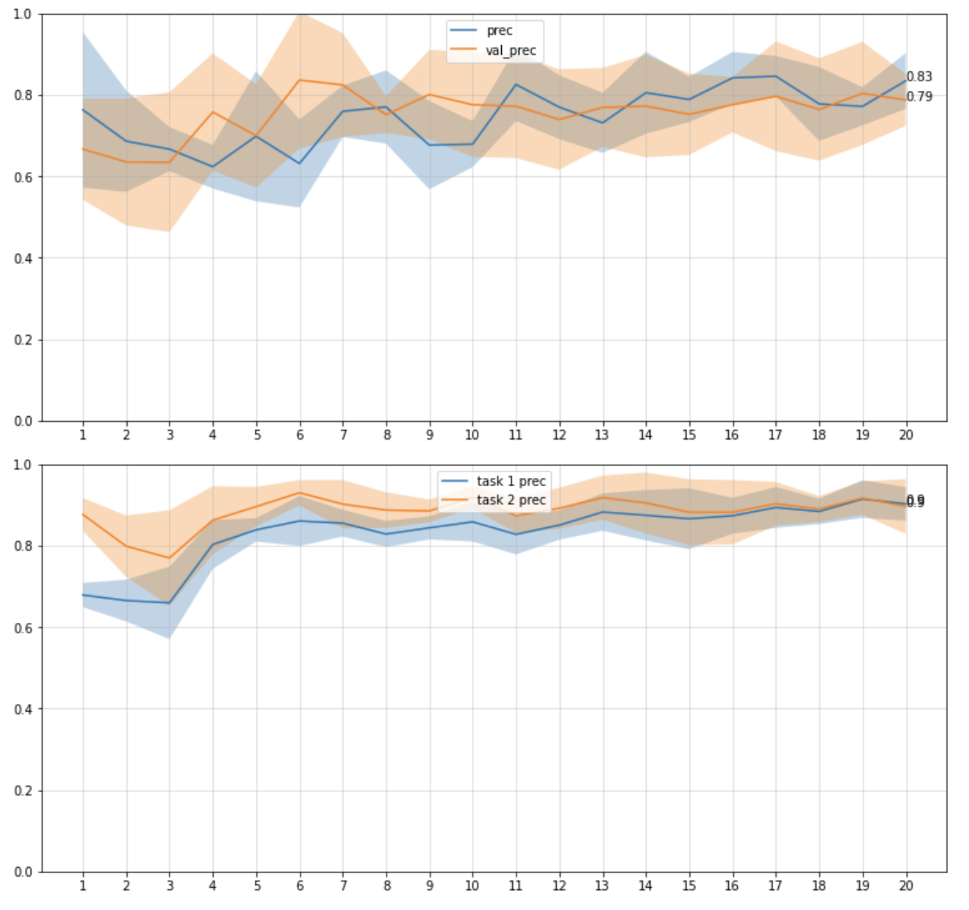

Results - EWC
Task 2 → task 1
Ewc_lambda = 0.7
Model evaluation
on tasks

Slide 35




Results - EWC
Task 2 → task 1
Ewc_lambda = 10
Model evaluation
on tasks

Slide 36


Task 2 → Shenzhen dataset Task 3 → Stanford dataset
Results - EWC
Task 3 only
Model evaluation
on tasks

Slide 37


Task 2 → Shenzhen dataset Task 3 → Stanford dataset
Results - EWC
Task 3 only
Model evaluation
on tasks

Slide 38


Task 2 → Shenzhen dataset Task 3 → Stanford dataset
Results - EWC
Task 3 → task 2 Ewc_lambda = 0
Task 3 only

Slide 39


Task 2 → Shenzhen dataset Task 3 → Stanford dataset
Results - EWC
Task 3 → task 2 Ewc_lambda = 0.7
Task 3 only

Slide 40


Task 2 → Shenzhen dataset Task 3 → Stanford dataset
Results - EWC
Task 3 → task 2 Ewc_lambda = 10
Task 3 only

Slide 41


Task 2 → Shenzhen dataset Task 3 → Stanford dataset
Results - EWC
Task 3 → task 2
Ewc_lambda = 0
Model evaluation
on tasks

Slide 42


Task 2 → Shenzhen dataset Task 3 → Stanford dataset
Results - EWC
Task 3 → task 2
Ewc_lambda = 0.7
Model evaluation
on tasks

Slide 43


Task 2 → Shenzhen dataset Task 3 → Stanford dataset
Results - EWC
Task 3 → task 2
Ewc_lambda = 10
Model evaluation
on tasks

Slide 44


Task 2 → Shenzhen dataset Task 3 → Stanford dataset
Results - ELLA
Task 2 → task 3 Model evaluation
on tasks
Task 3 → task 2 Model evaluation
on tasks

Slide 45


Task 2 → Shenzhen dataset Task 3 → Stanford dataset
Results - SVM
Task 2 → task 3 Model evaluation
on tasks
Task 3 → task 2 Model evaluation
on tasks

Slide 46
Main conclusions
Order of tasks is relevant
EWC is particularly sensitive to lambda (forgetting term)
EWC is sensitive to the final parameterization of first model (if the parameterization lies in a difficult region of the parameter space after training on task A, model will struggle to optimize on second task)
dropout was important when using EWC (without dropout, model struggles to make progress on second task)

Slide 47
Thanks

